Slide 1
Marine Ecology and Fisheries
Energy Transfer and trophic structure (Ch 14 – previously assigned)
Food from the Sea (Ch 17)

Slide 2
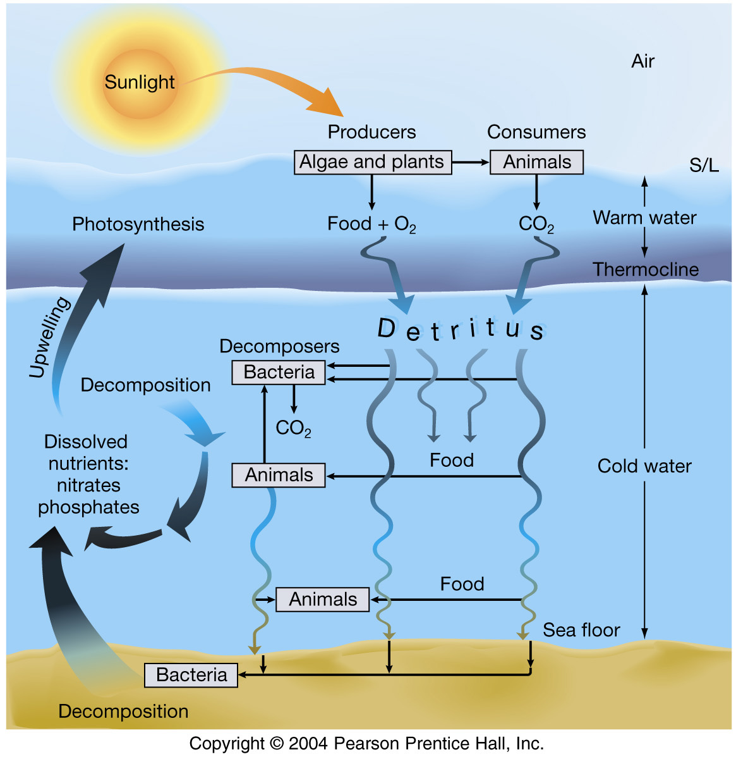
Matter Cycles
Atoms of each element not created or destroyed but cycled through inorganic to organic back to inorganic forms
Production of biomass limited by nutrients
Notes:
Walk through phosphorus cycle

Slide 3
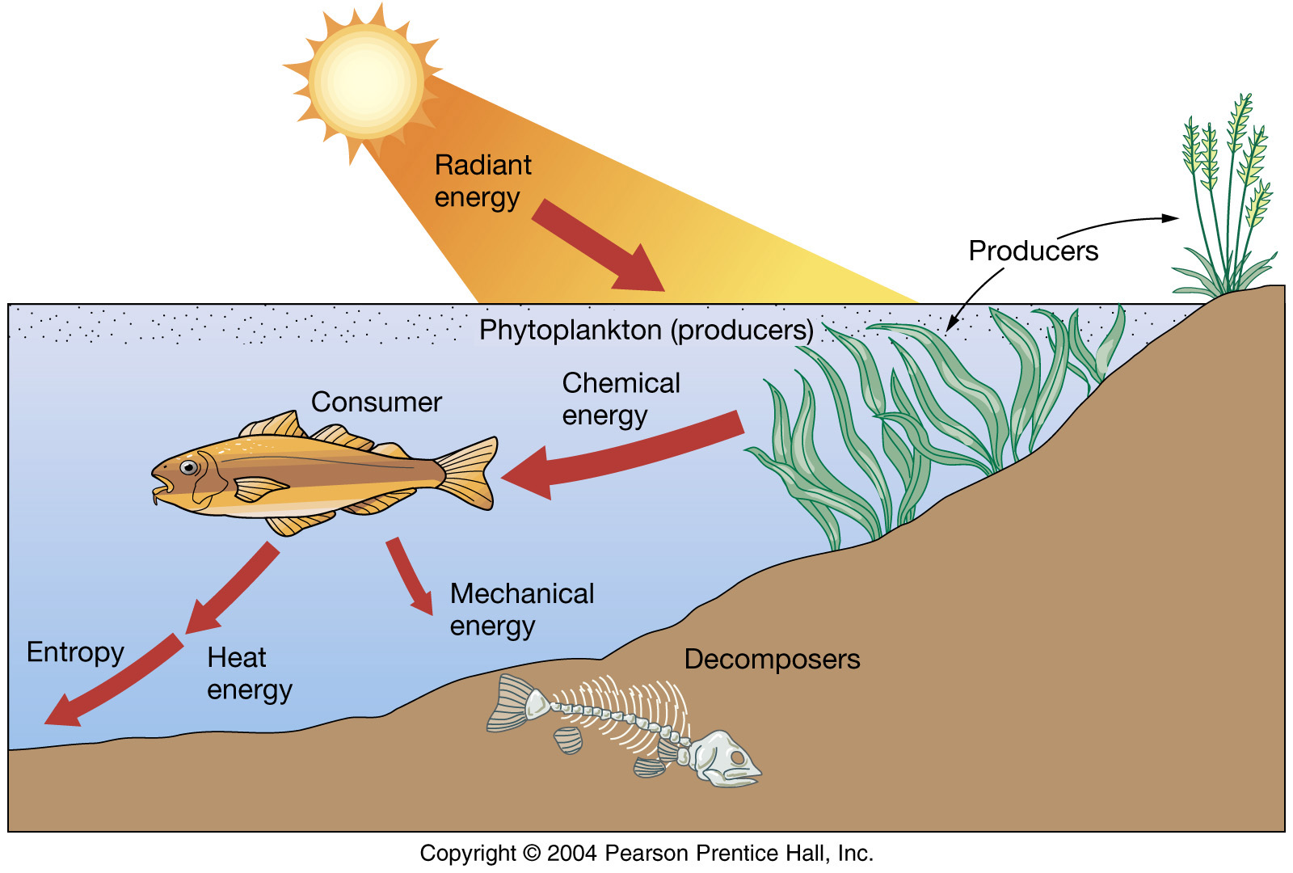
Energy Flows
Electromagnetic radiation->
Chemical Energy->
Mechanical Energy -> heat energy -> electromagnetic radiation
Primary production limited by light, consumers limited by efficiency of energy transfer

Slide 4
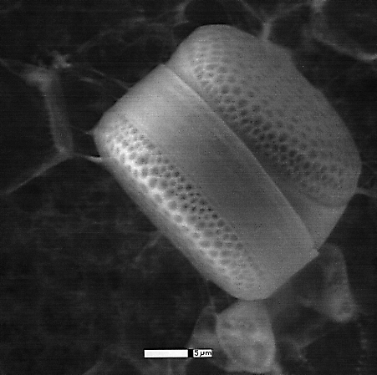
Ocean Ecosystem Structure
Trophic levels
and dynamics

Slide 5
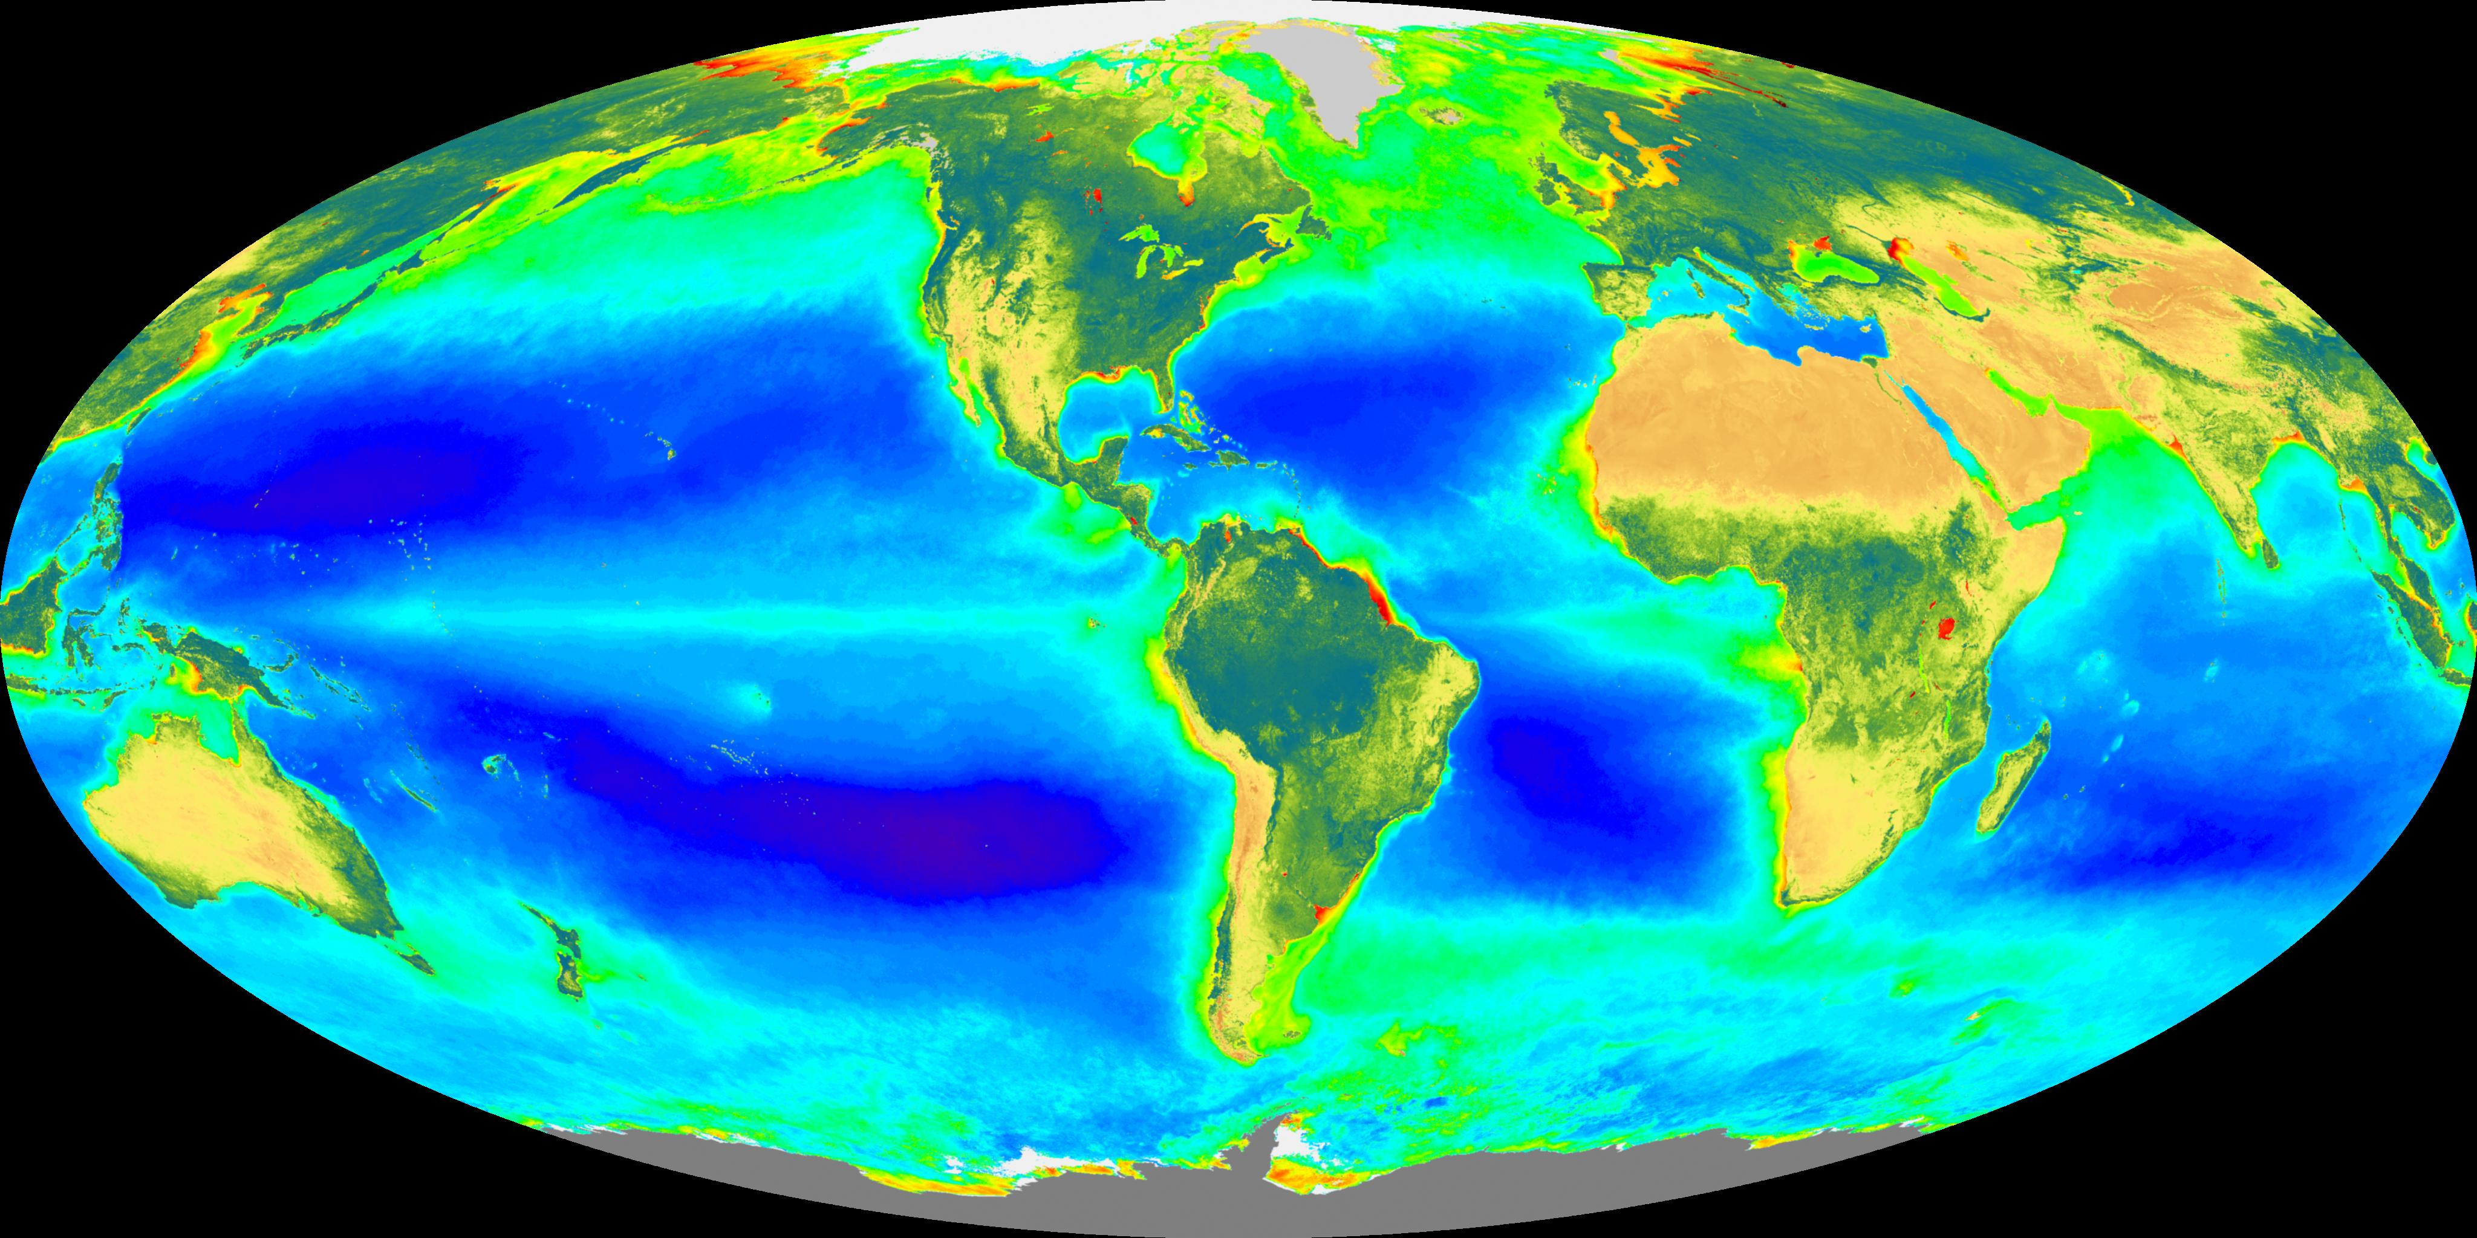
Primary Productivity

Slide 6
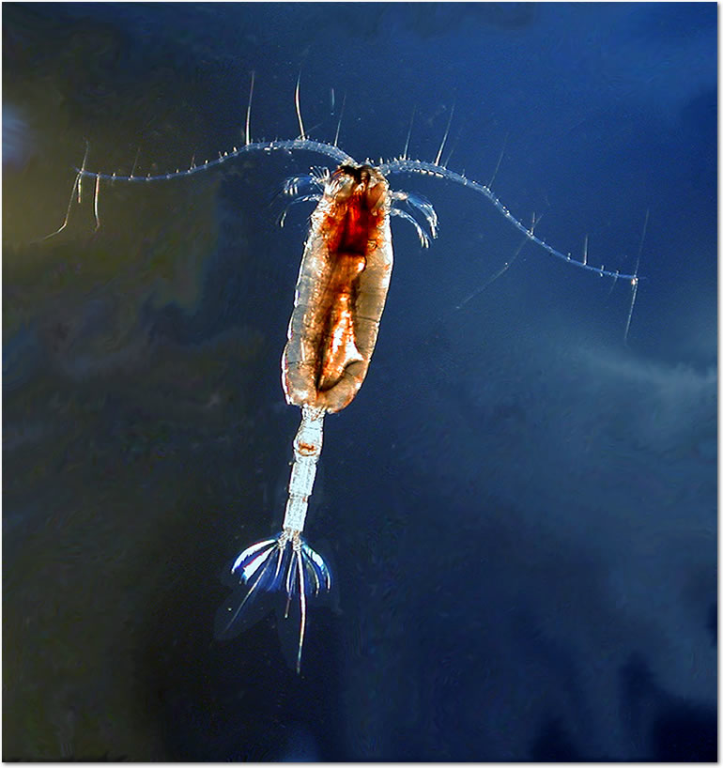
Ocean Ecosystem Structure
Trophic levels
and dynamics

Slide 7
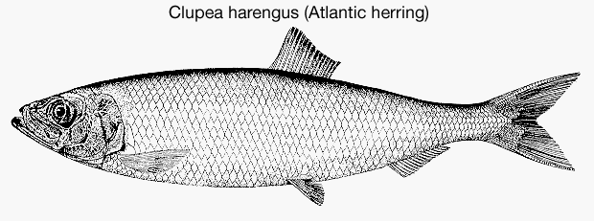
Ocean Ecosystem Structure
Trophic levels
and dynamics

Slide 8
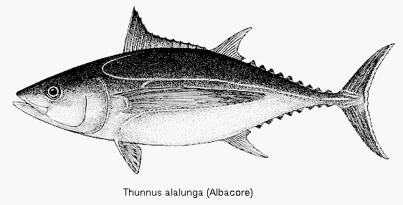
Ocean Ecosystem Structure
Trophic levels
and dynamics

Slide 9
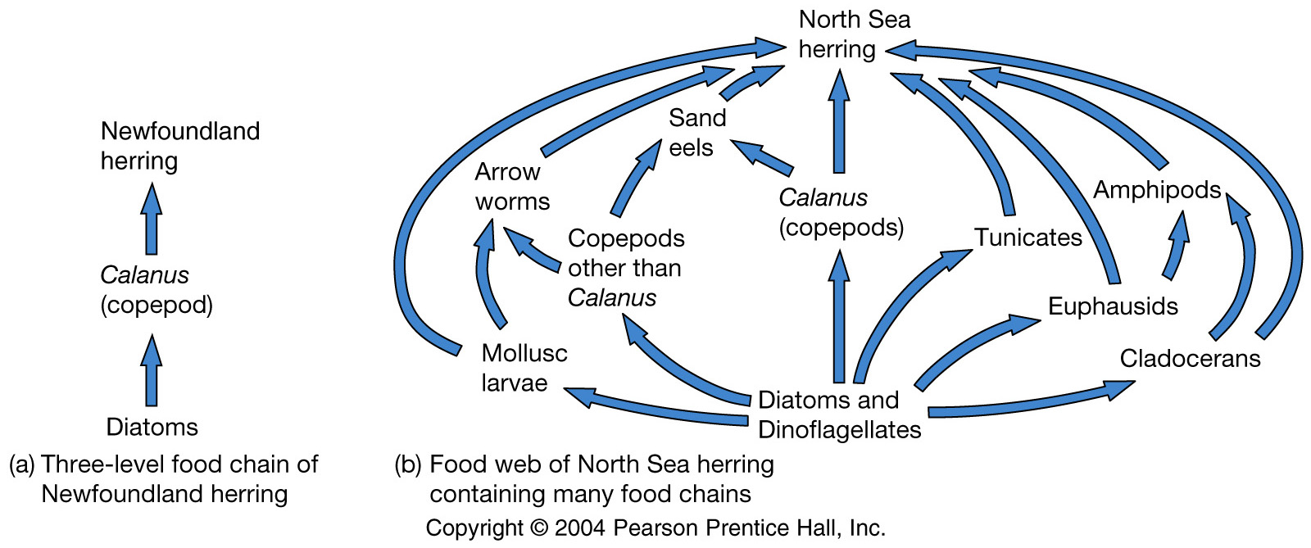
Ocean Ecosystem Structure
A simple food chain
a more complex Food Web
Trophic levels can be decimal: North Sea Herring = 3.5

Slide 10
Sea Bottom Ecosystems
Grazing Food Chain
Phytoplankton Zooplankton Nekton
Detritus Deposit Feeder Nekton
Detrital Food Chain

Slide 11
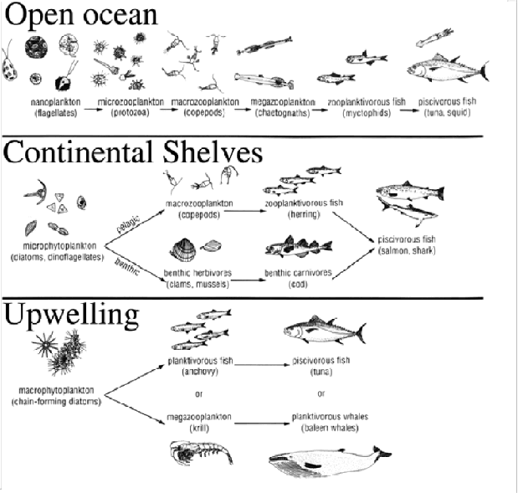
Ocean Ecosystem Structure
Food Chains are shorter in highly productive areas

Slide 12
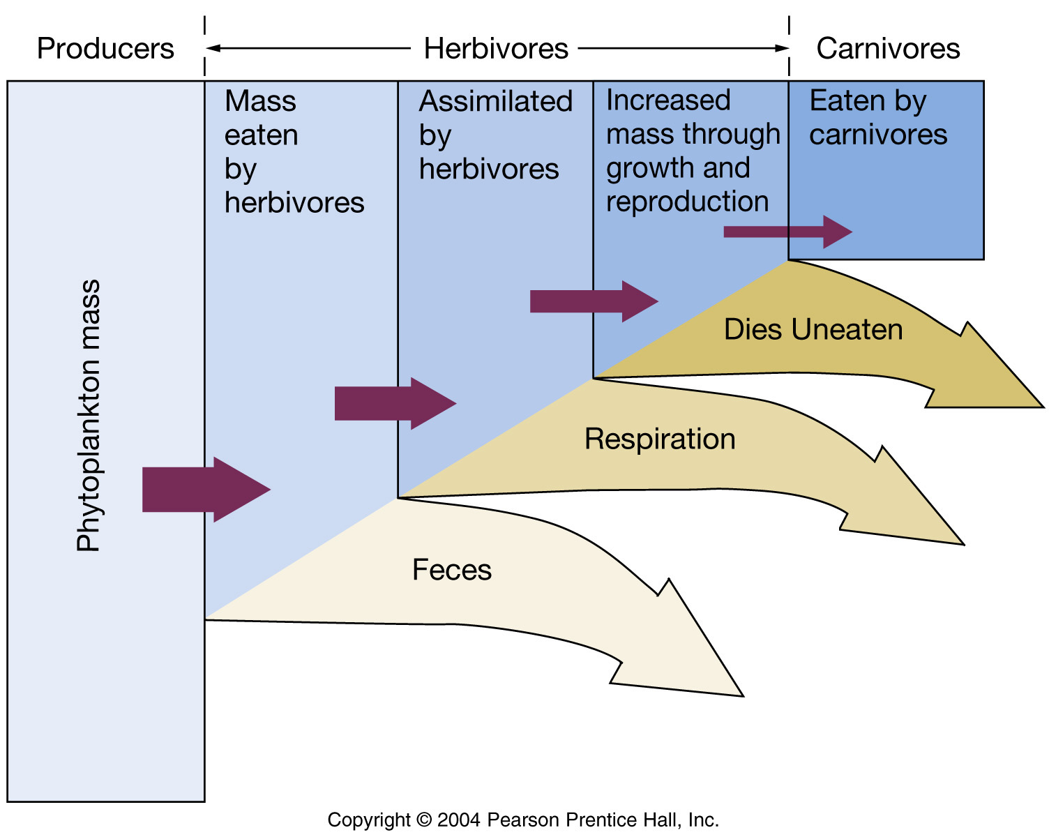
Ocean Ecosystem Structure
Energy Transfer between Trophic Levels is not efficient

Slide 13
Ocean Ecosystem Structure
Energy Transfer between Trophic Levels is not efficient

Slide 14
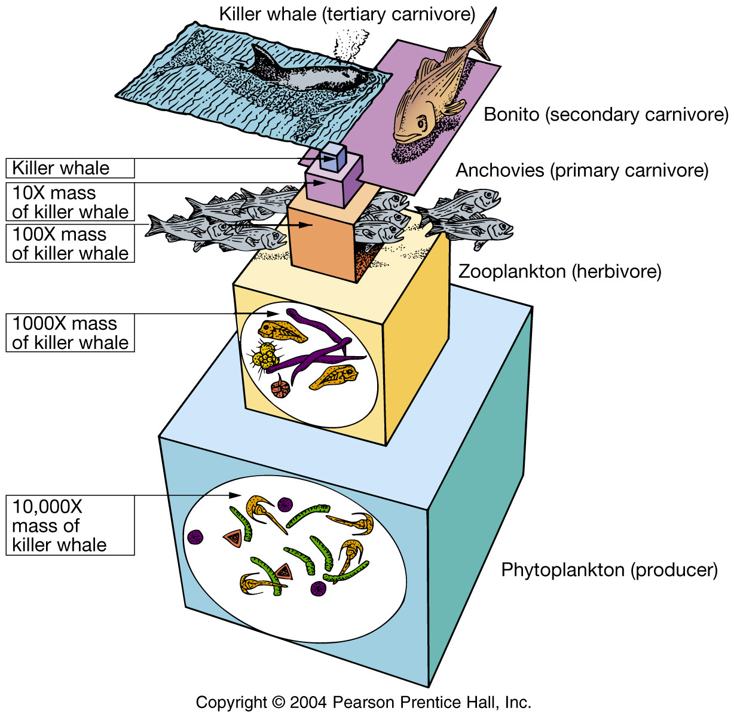
Higher trophic levels will have smaller biomass
In the ocean, higher trophic levels tend to have larger individuals

Slide 15
Microbial Loop
What happens to the chemical energy in the feces? In the dead bodies? Also have exudate (organic molecules) leaking from primary producers and “munchate” from herbivores. Why is this diagramed as an energy loss?

Slide 16
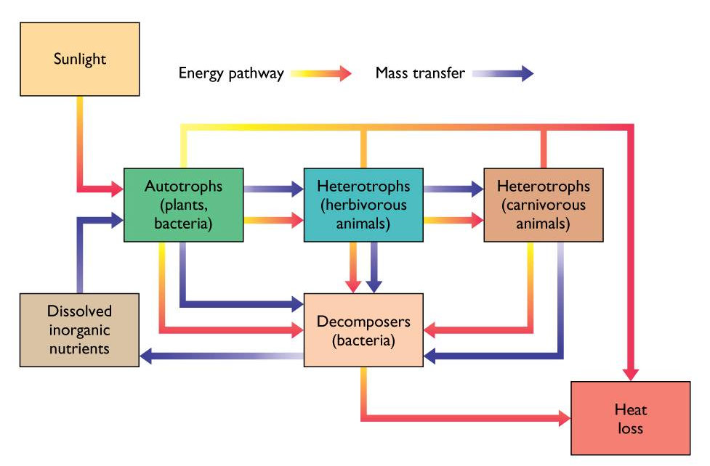
Microbial Loop
Consumed by bacteria. The bacteria are generally too small to be grazed, so don’t enter the flow towards larger organisms. The energy/biomass stays at small sizes until energy is dissipated and mass is in the inorganic form
Notes:
Why do we just consider this a loss when we are diagramming trophic structure? Generally too small to be grazed, so don’t enter the flow towards larger organisms. There is recycling within the microbial community

Slide 17
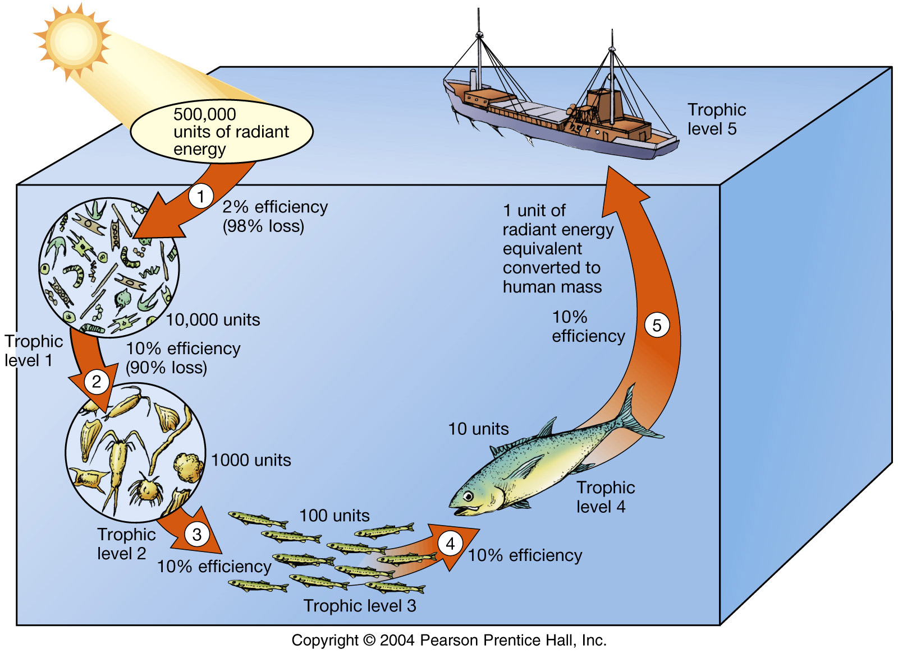
Ocean Ecosystem Structure
Energy transfer efficiency and trophic level will determine how much food can be sustainably harvested from the sea

Slide 18
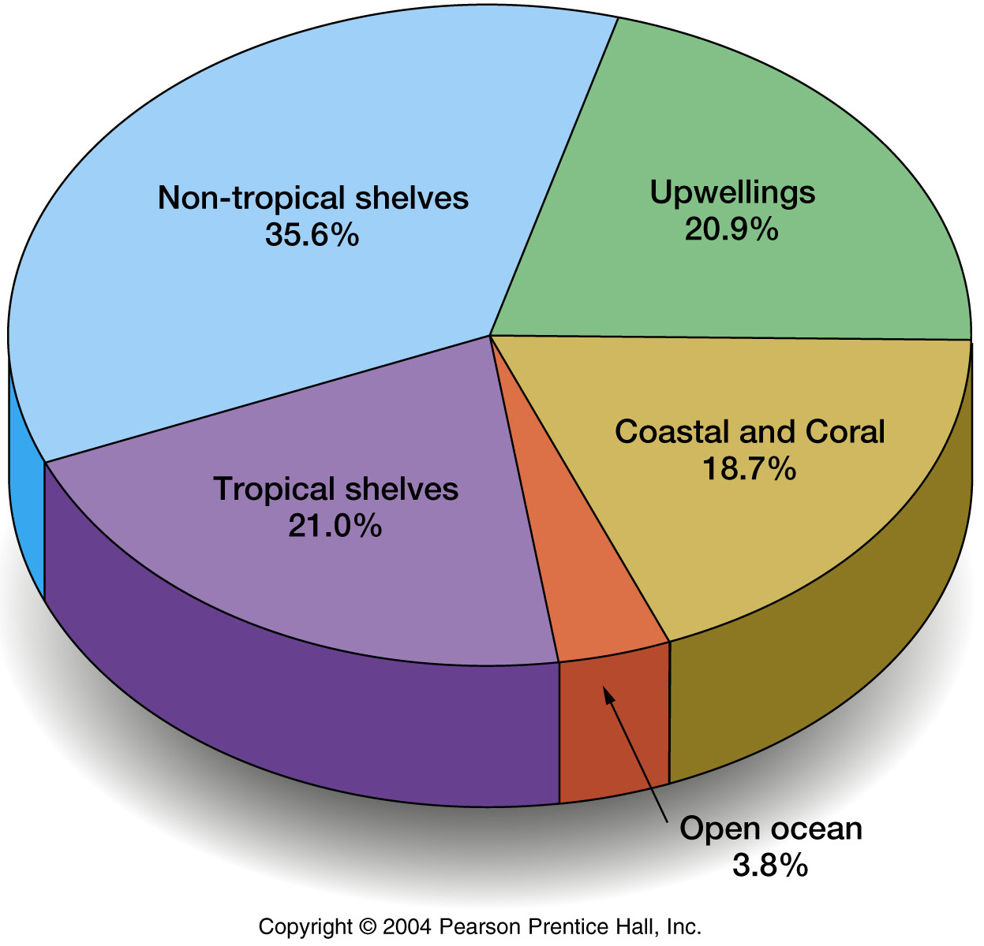
Where are major fisheries?
Where the primary producers are.

Slide 19
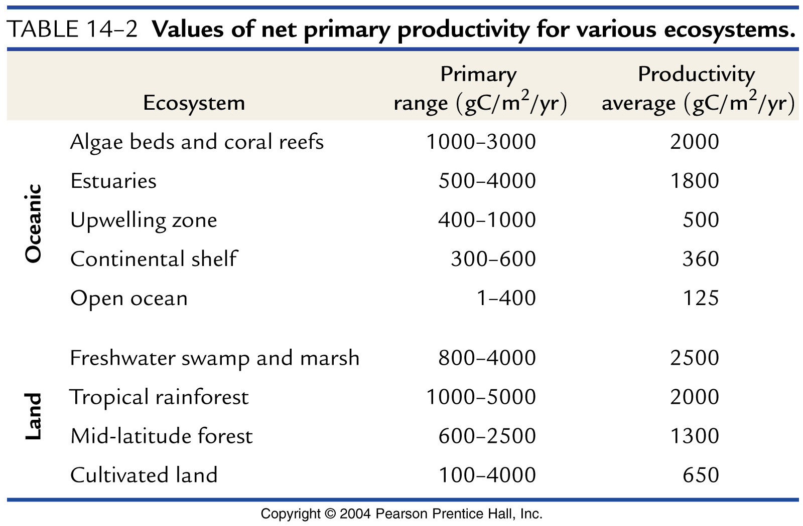
Ocean vs. Land Productivity

Slide 20
What is the maximum possible harvest (taking all the fish that are there)?

Slide 21
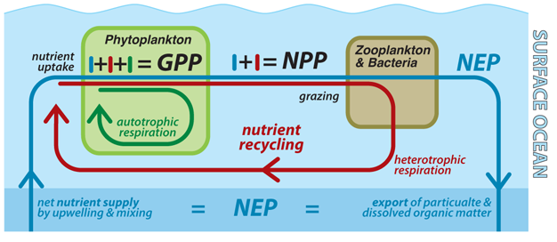
NPP is what determines the magnitude of energy that can flow to higher trophic levels
NPP limits the amount of biomass at higher trophic levels
If you fish at trophic level 1, theoretical maximum harvest = .10*NPP
If you fish at trophic level 2, theoretical maximum harvest = .10*.10*NPP
GPP = Gross Primary Production
NPP = Net Primary Production
NEP = Net Ecosystem Production = New Production = Export Production
Notes:
Once we account for the fact that we are removing higher on the trophic chain, the total amount of fish that can be removed is limited by the NPP (not new Production, since trophic transfer efficiencies are low and the material is recycled even if the energy is not).

Slide 22
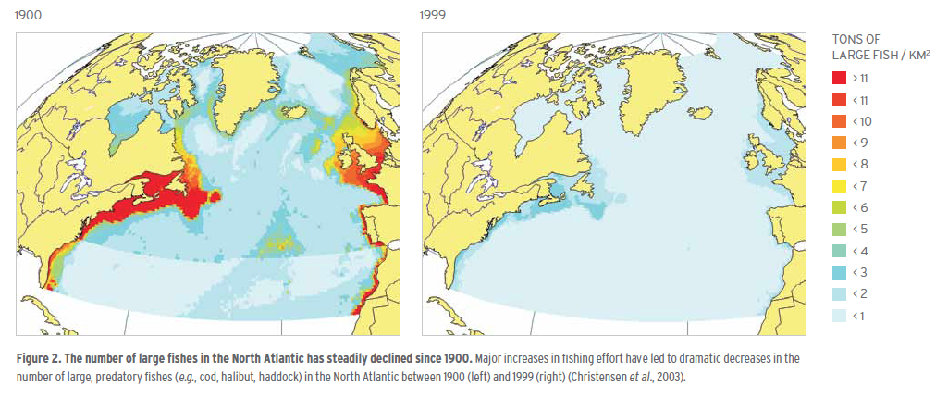
Large Fish Populations 1900-1999
Large predatory fishes (cod, halibut, haddock)
Globally: Large Fish Biomass 10% of pre-industrial levels
Notes:
What happens when you do take all the fish that are there?
From Monterrey Bay Aquarium State of Seafood report

Slide 23
What is the maximum possible sustainable harvest?
Fisheries become overexploited (decline) if more than 10% of the theoretical maximum harvest is removed
This is an empirical observation. If too many fish are removed they cannot be replaced effectively enough. It takes time for fish to grow and reproduce

Slide 24
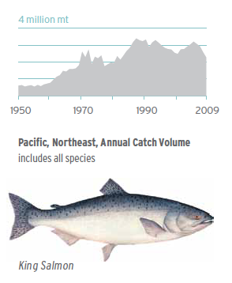
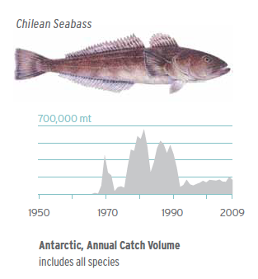
Strictly managed fishery
overfished
Notes:
Overfishing driven by development of very effective large scale industrial fisheries. Technology (finding fish, freezing fish on board, etc.)

Slide 25
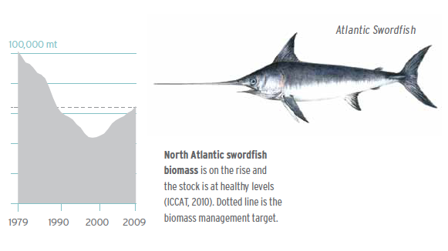
recovering
Notes:
As long as there is enough of a population remaining, stocks will eventually recover. Swordfish was relatively resilient. Cod is not recovering so fast. Bottom ecology more complex, temperature changes may also be playing a role.

Slide 26
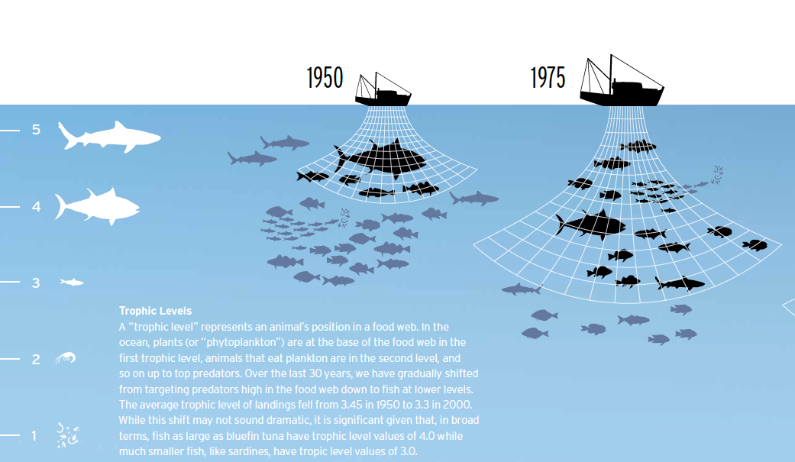
Average Trophic Level
3.45
3.3

Slide 27
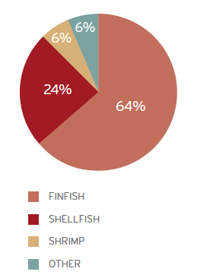
Aquaculture
Many different technologies (pens in open ocean, ponds and recirculating systems)
Shellfish least environmental impact
Wastes, pollution of coastal environment
Health of farmed and wild stock
Rapidly growing and evolving!

Slide 28
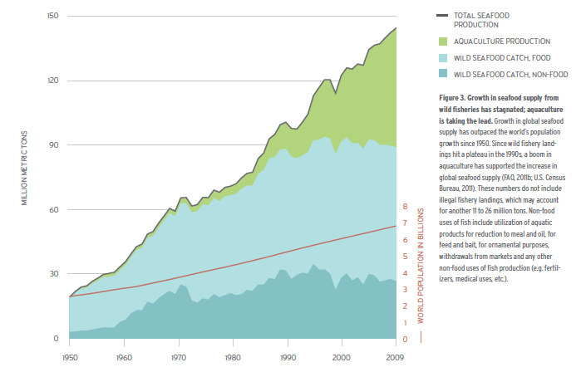
Total Seafood Supply
Sustainable wild catch will likely not exceed 110 tons (unless expands into Southern Ocean), but
will require strict management
Notes:
Concerns with aquaculture– required fish meal (esp salmon), pollution of coastal waters. Evolving rapidly, becoming more efficient and more sustainable.

Slide 29
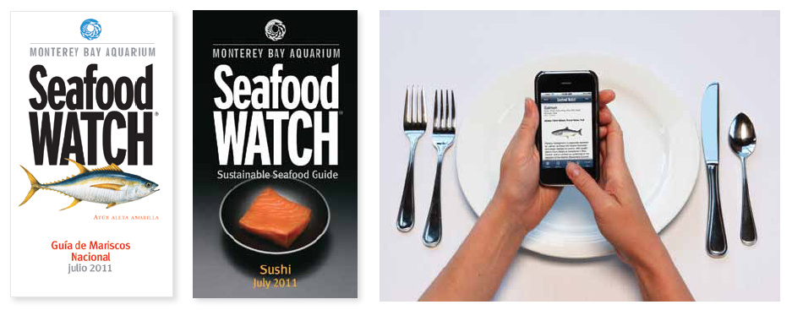
Consumer Choice vs. Regulation
Notes:
Both are probably helpful. Swordfish – expensive fish eaten by relatively few people was partially driven by consumers/chefs reducing demand
But hard to keep up, especially with farmed fish. And many people don’t have the luxury to have choices driven by anything other than price.

Slide 30
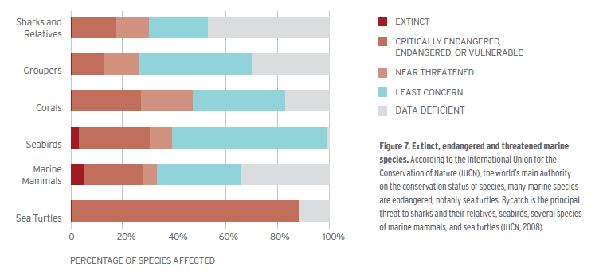
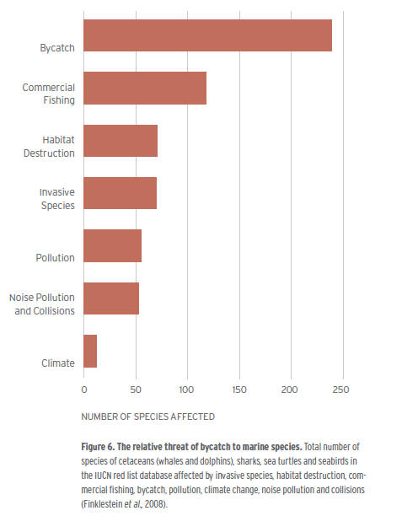
Endangered Marine Species

