Slide 1
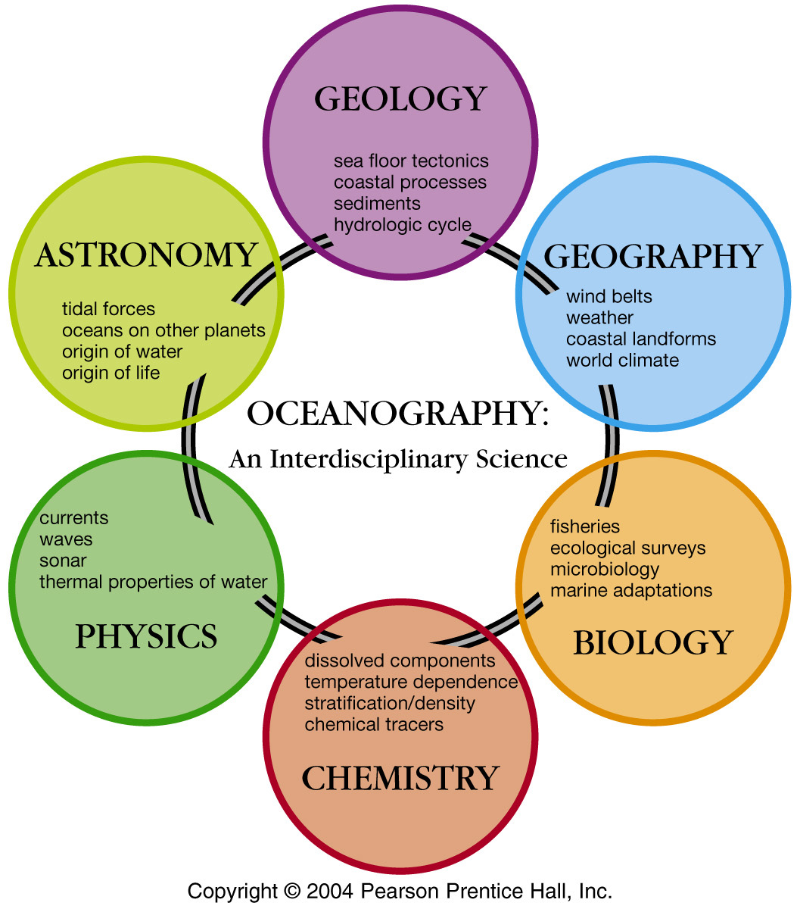
Notes:
Oceanography: Rooted in observations. Ultimately seek to understand processes from a bottom up (physics, chemistry, biochemistry) and top down (ecology, earth systems) perspective. Effort justified (and largely funded) for better predictions/management/use by society – fisheries, energy, impact on climate, military

Slide 2
Ocean Observations
Shipboard Oceanography – then and now
Other 21st century tools
  Moorings
  Drifters
  Submersibles
  Autonomous vehicles
  Satellites

Slide 3
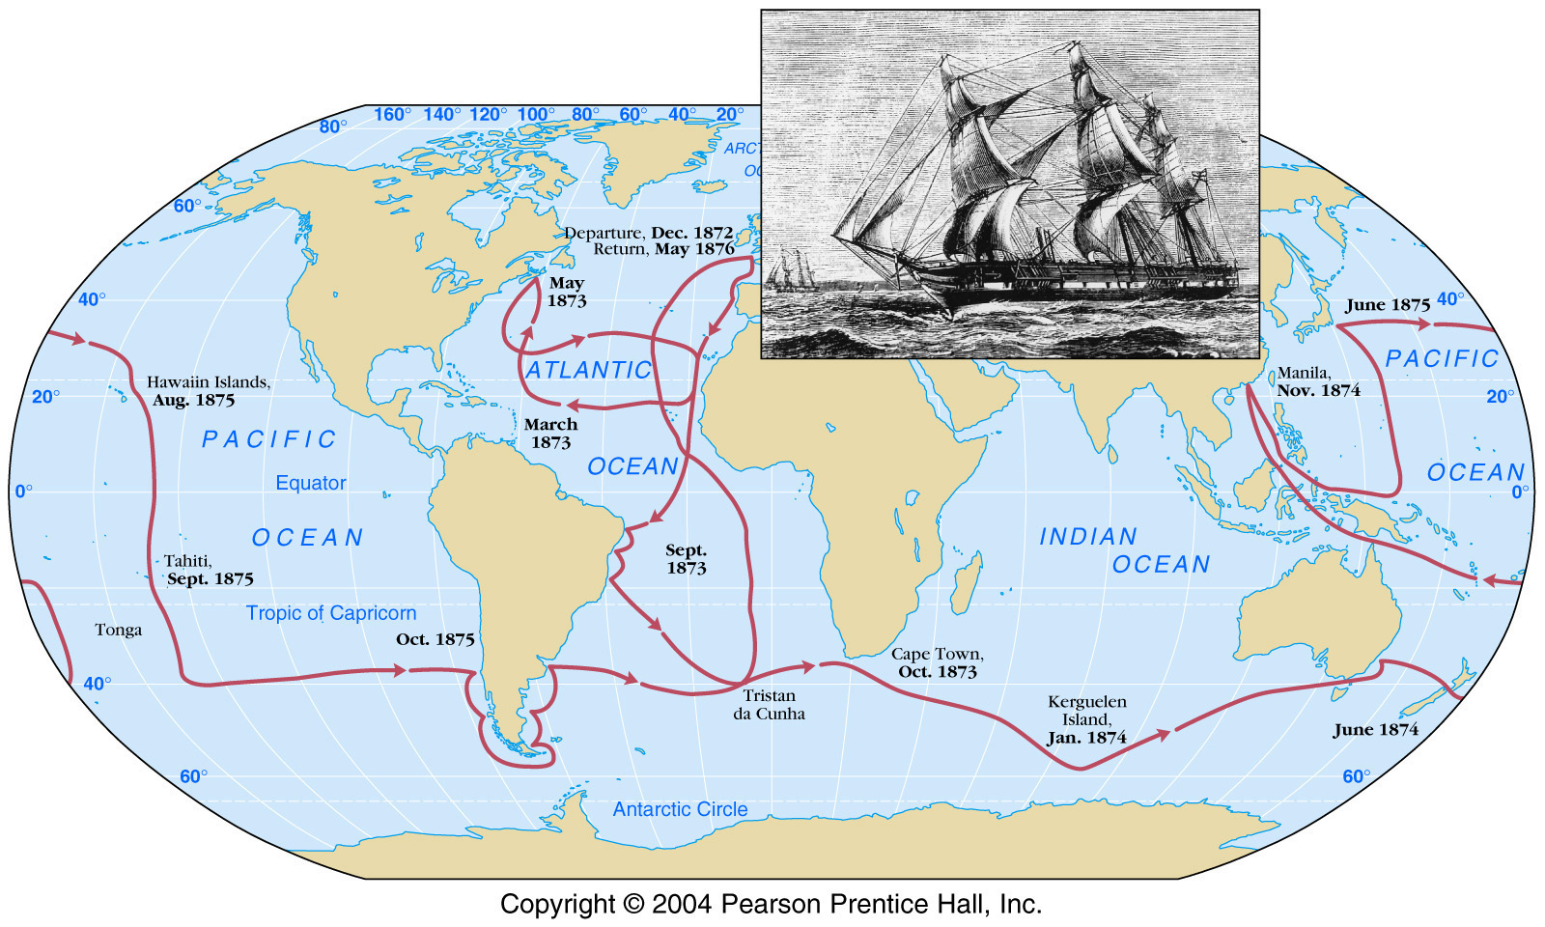
Challenger Expedition 1872-1876
HMS Challenger
Crew: 243
Scientists: 6
Duration of Expedition: 4 years
Distance sailed: 127,000 km (68,890 miles)
Number of sampling stations: 362
Number of depth soundings made: 492
Number of dredges taken: 133
Number of new species of animals and plants discovered: 4,700

Slide 4
Stated goals
To investigate the physical conditions of the deep sea in the great ocean basins (as far as the neighborhood of the Great Southern Ice Barrier) in regard to depth, temperature, circulation, specific gravity and penetration of light.
To determine the chemical composition of seawater at various depths from the surface to the bottom, the organic matter in solution and the particles in suspension.
To ascertain the physical and chemical character of deep-sea deposits and the sources of these deposits.
To investigate the distribution of organic life at different depths and on the deep seafloor.
http://aquarium.ucsd.edu/Education/Learning_Resources/Challenger/science.php
Notes:
http://aquarium.ucsd.edu/Education/Learning_Resources/Challenger/science.php
Natural History Museum: Prime science motivation to examine life in deep sea. How deep can life survive? Is deep sea live “living fossils”? Also interest in laying deep sea telegraph cables– what’s down there?

Slide 5
Standard set of measurements/procedures at Challenger Stations
Weather
Surface currents and currents at shallow depths
Water depth
Temperature with depth
Water samples collected at various depths
Samples of biota at various depths
Seafloor samples
Notes:
The standard set of obserations made and samples taken at each of the 360 stations were:
water depth
temperature at various depths
weather conditions
water conditions at surface and sometimes at depth
seafloor samples
water samples
samples of plant and animal life at various depths

Slide 6
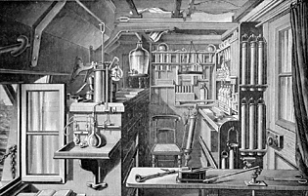
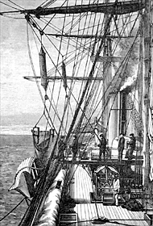
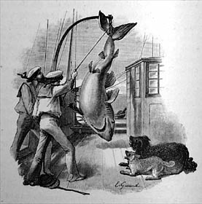

Slide 7
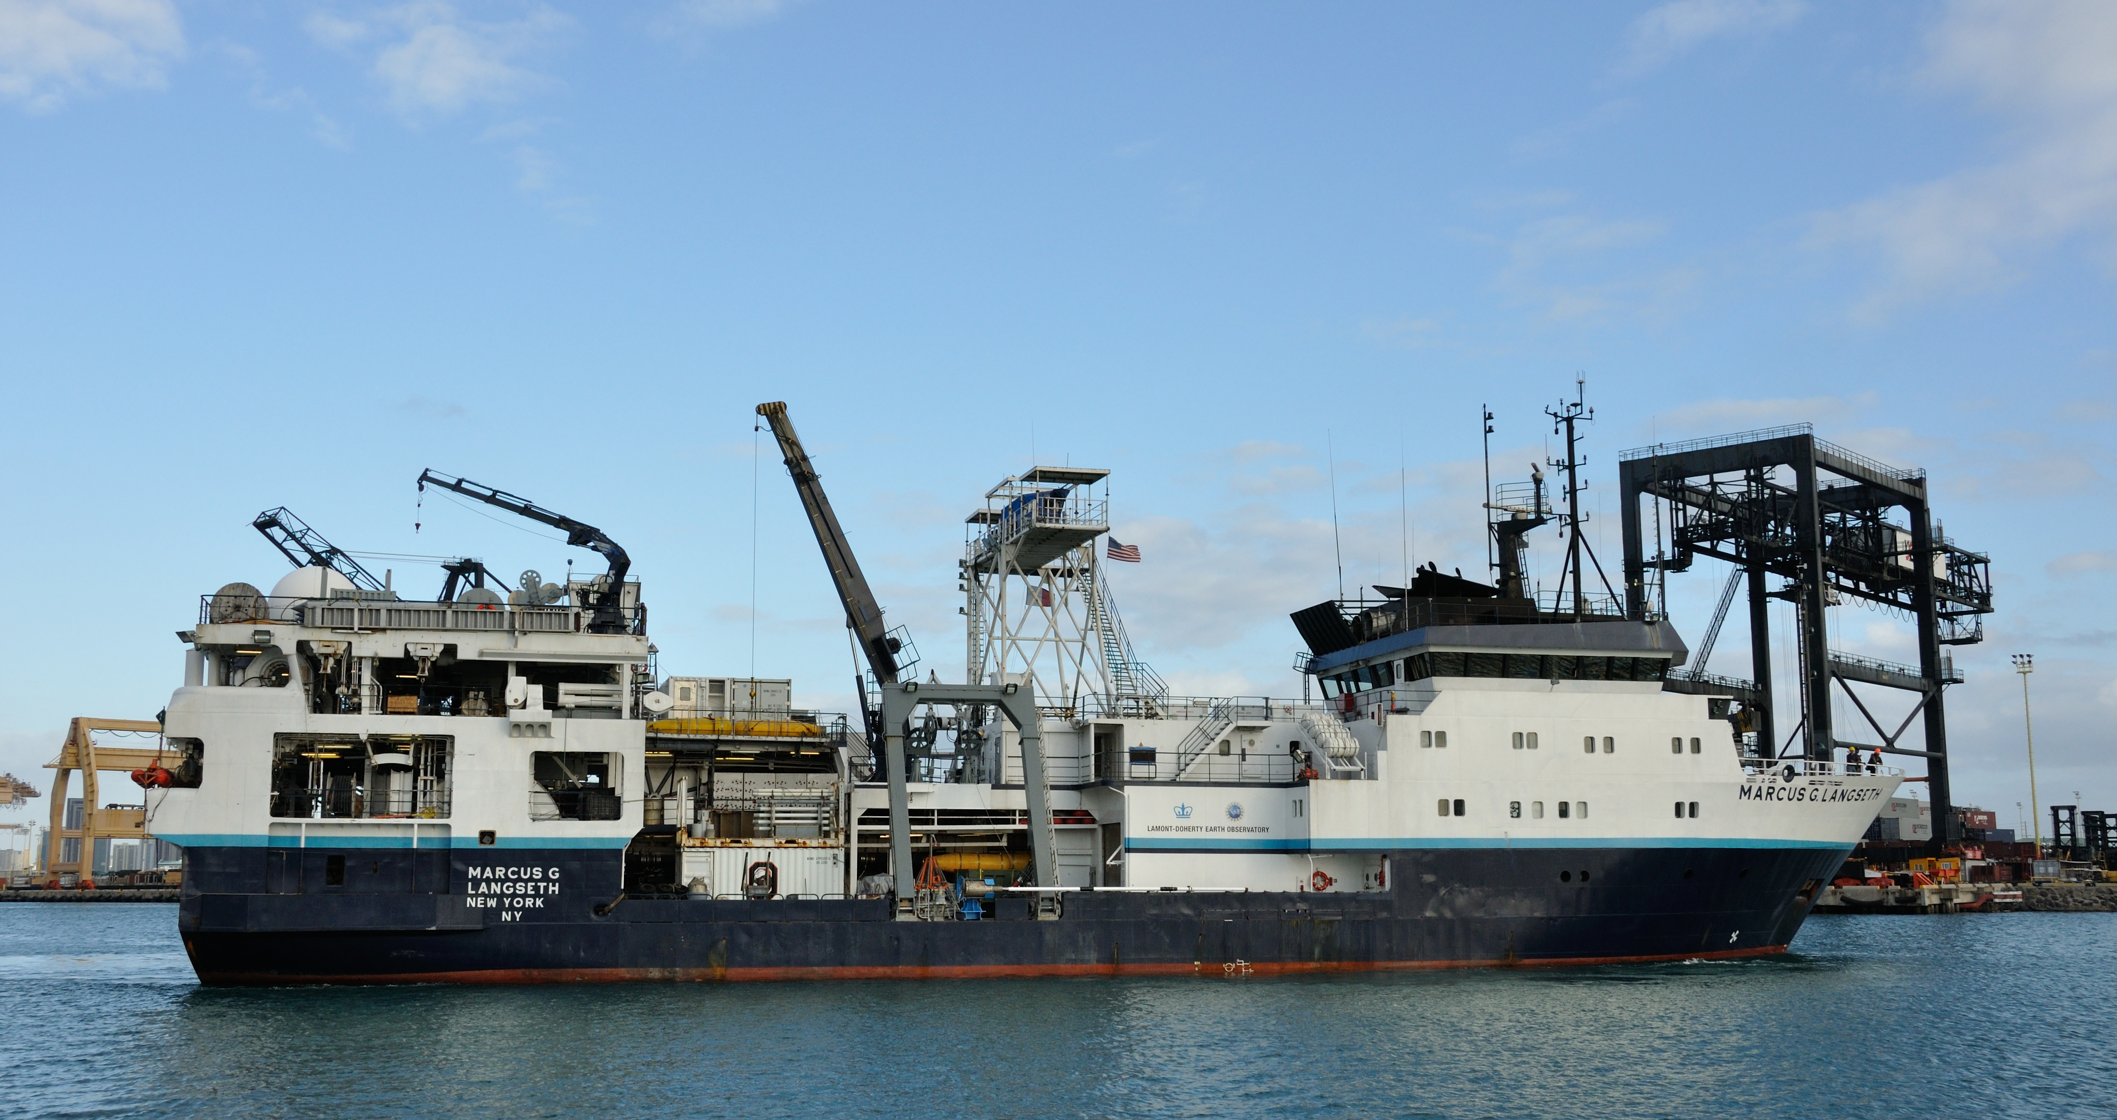
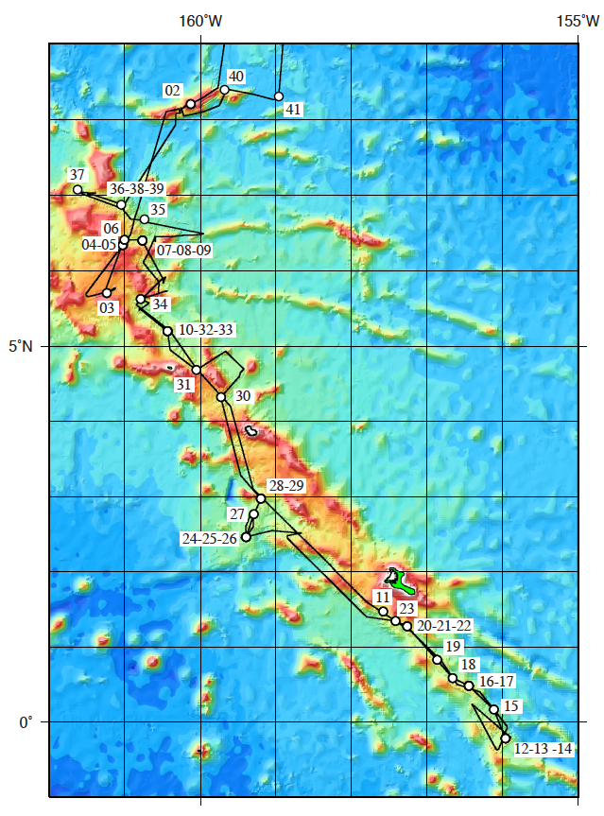
A more recent expedition…
Goals: Collect sediment samples suitable for paleoceanographic research on past changes in the tropical ocean/atmosphere system
Notes:
Crew: 243 about 30
Scientists: 6 (intl) 17 (U.S.)
Duration of Expedition: 4 years 25 days
Distance sailed: 127,000 km (68,890 miles) 1400 km
Number of sampling stations: 362 25
Number of depth soundings made: 492 many, many
Number of dredges taken: 133 41 cores
Number of new species of animals and plants discovered: 4,700 none:(

Slide 8
Measurements/procedures
Underway measurements:
  Temperature, pCO2 from engine intake waters
  Upper ocean current measurements
  Bathymetry
  Sub-bottom structure
At stations
  Temperature, salinity, dissolved oxygen, flouresence, turbidity continuously with depth
  Water samples at selected depths
  Sediment samples three ways

Slide 9
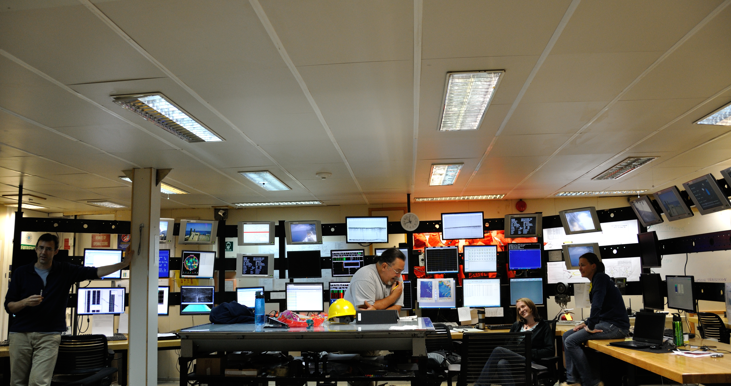
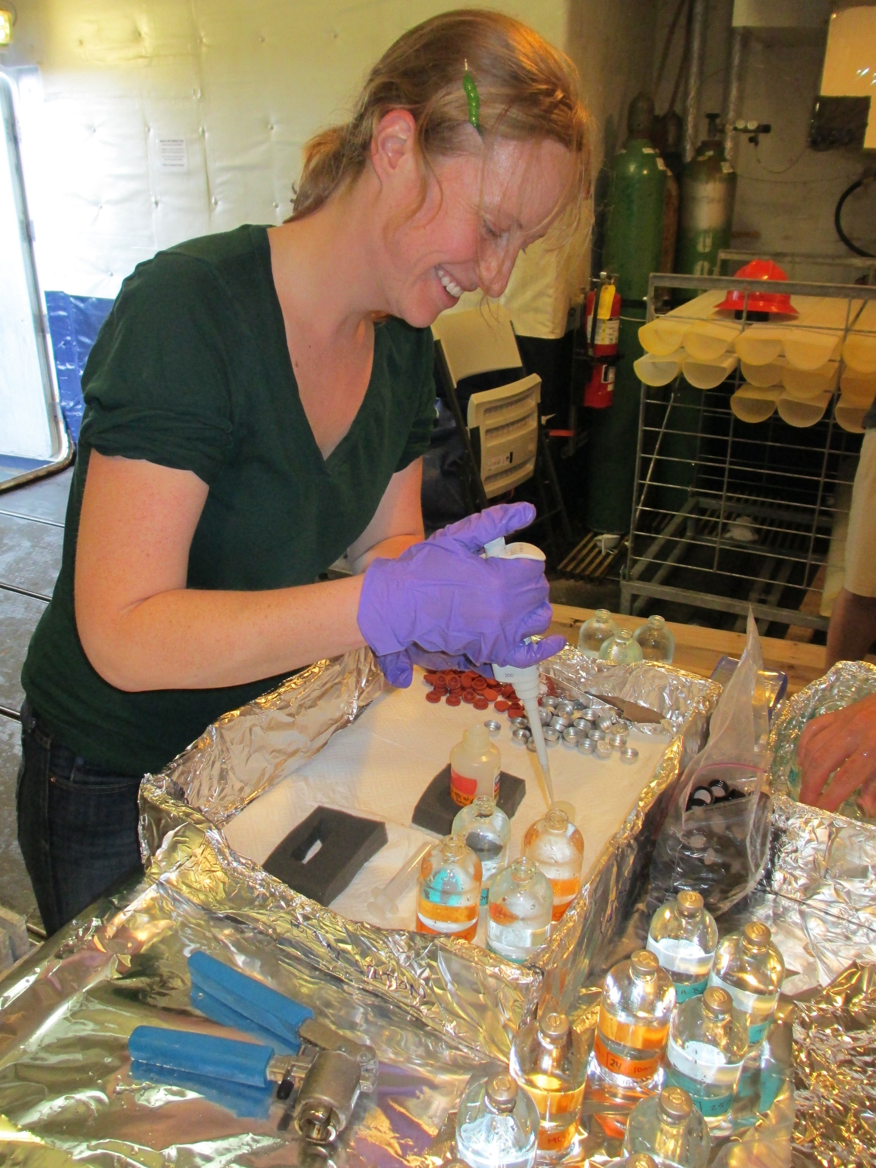
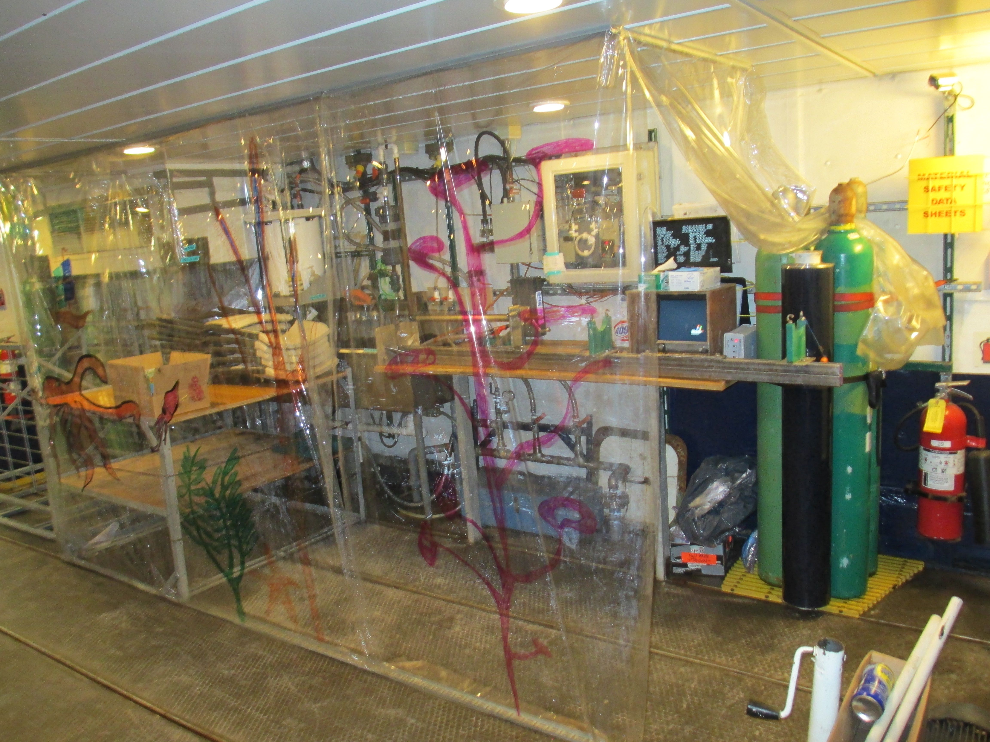

Slide 10
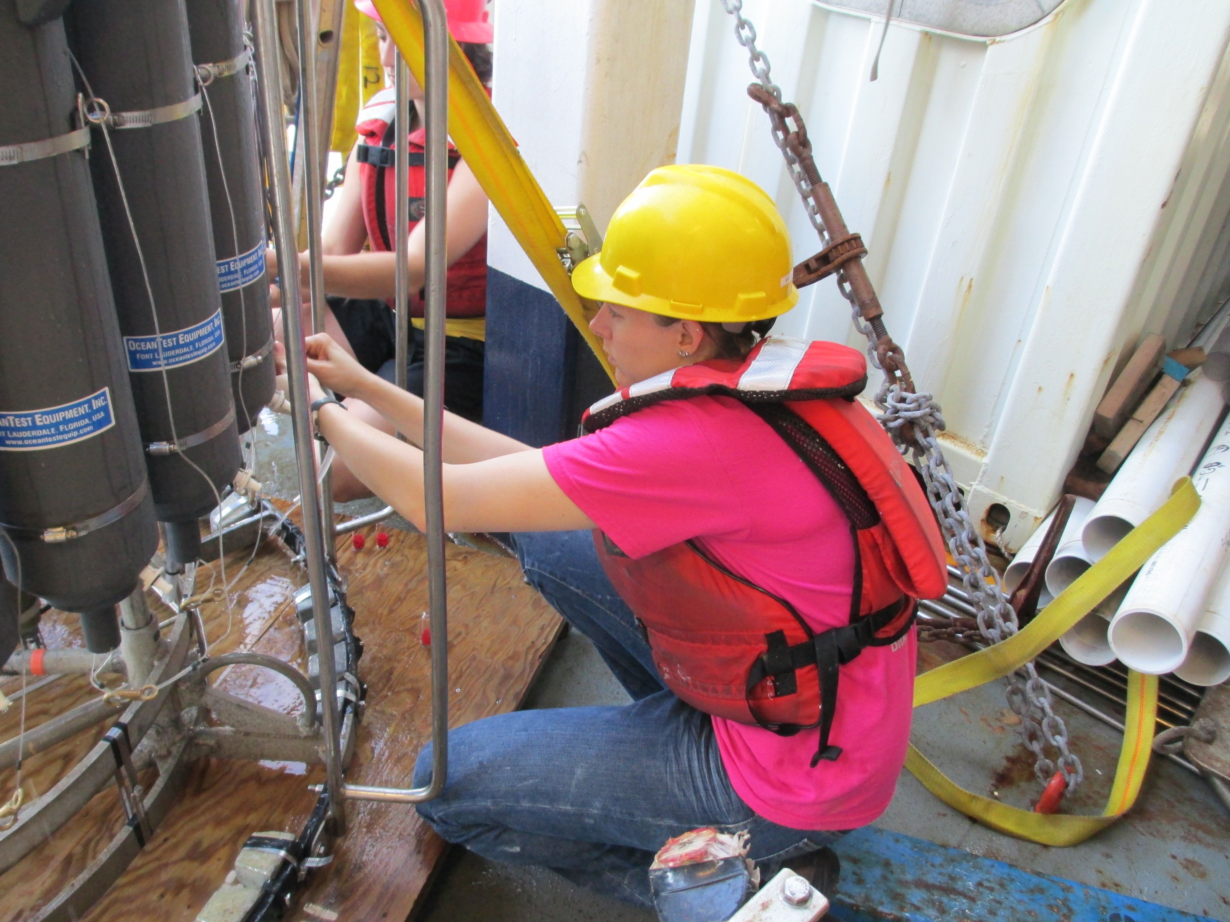
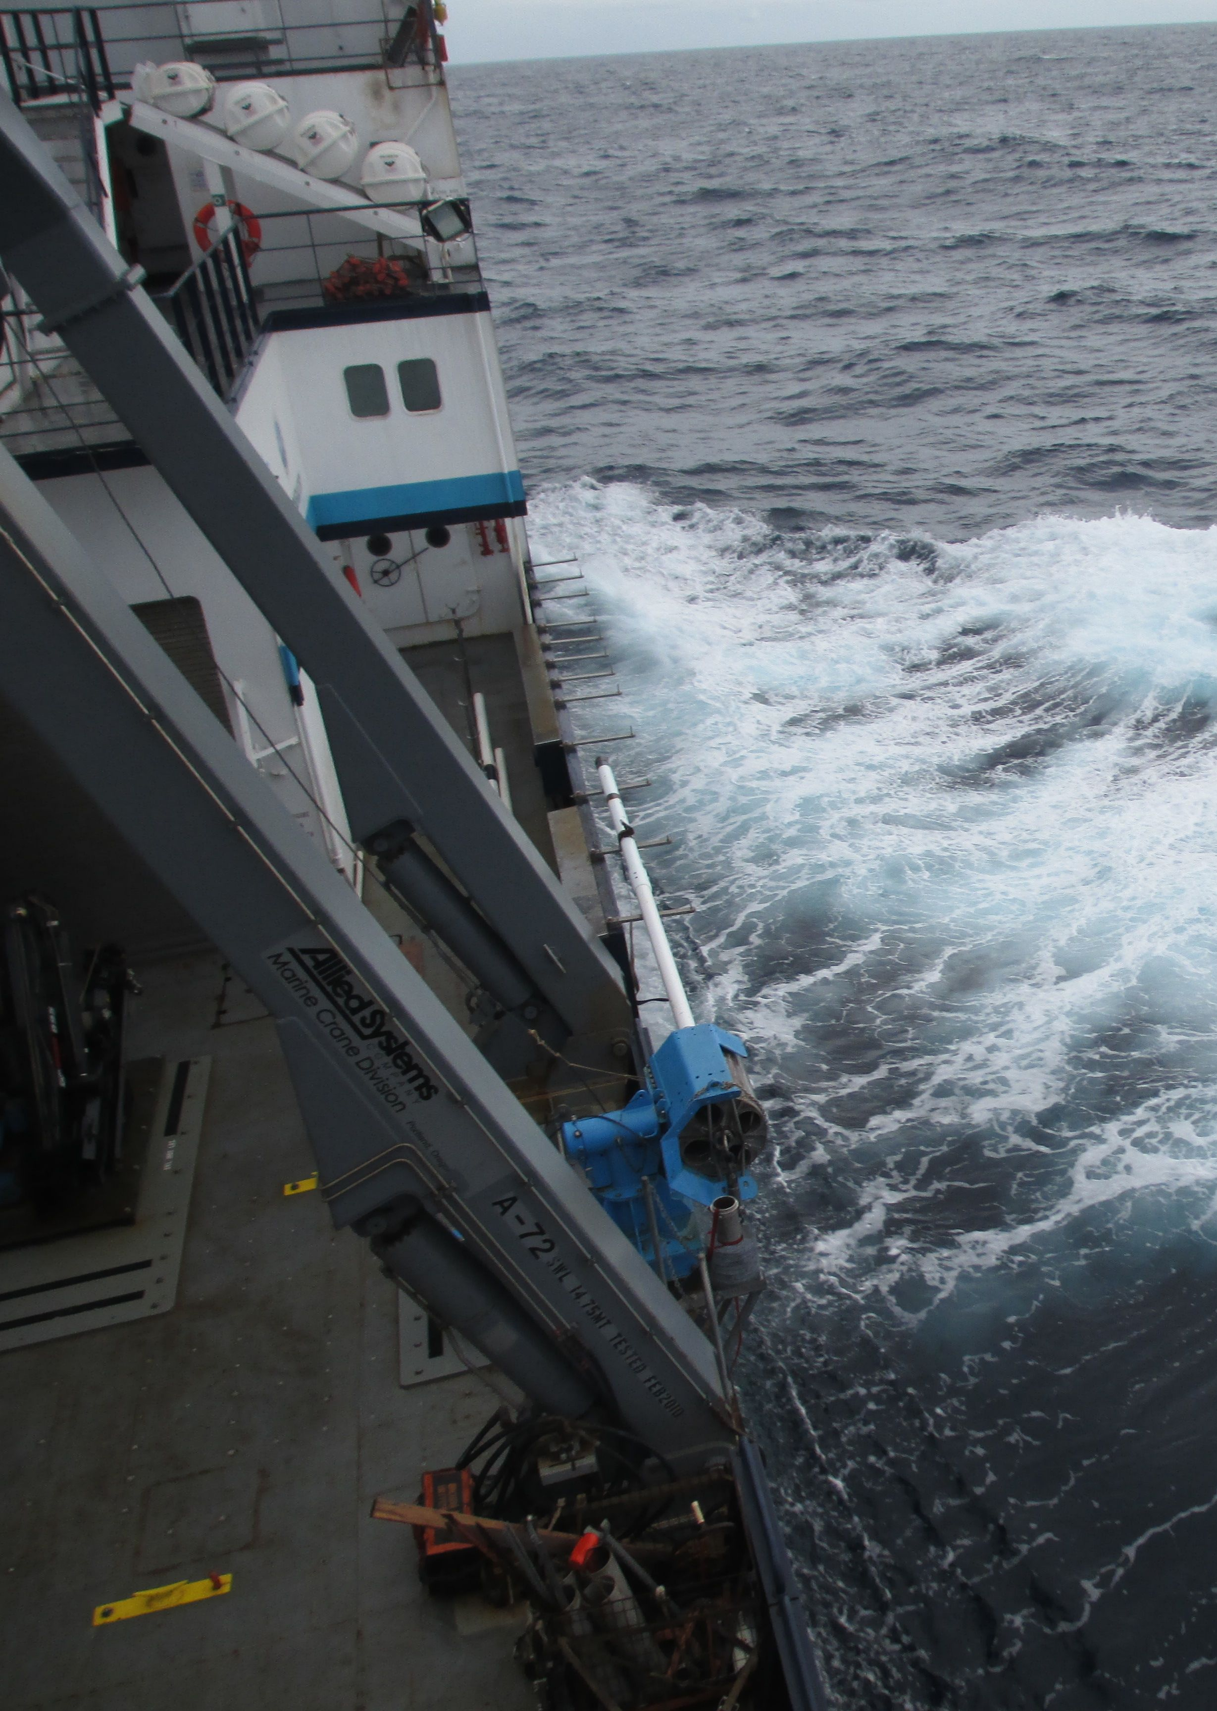
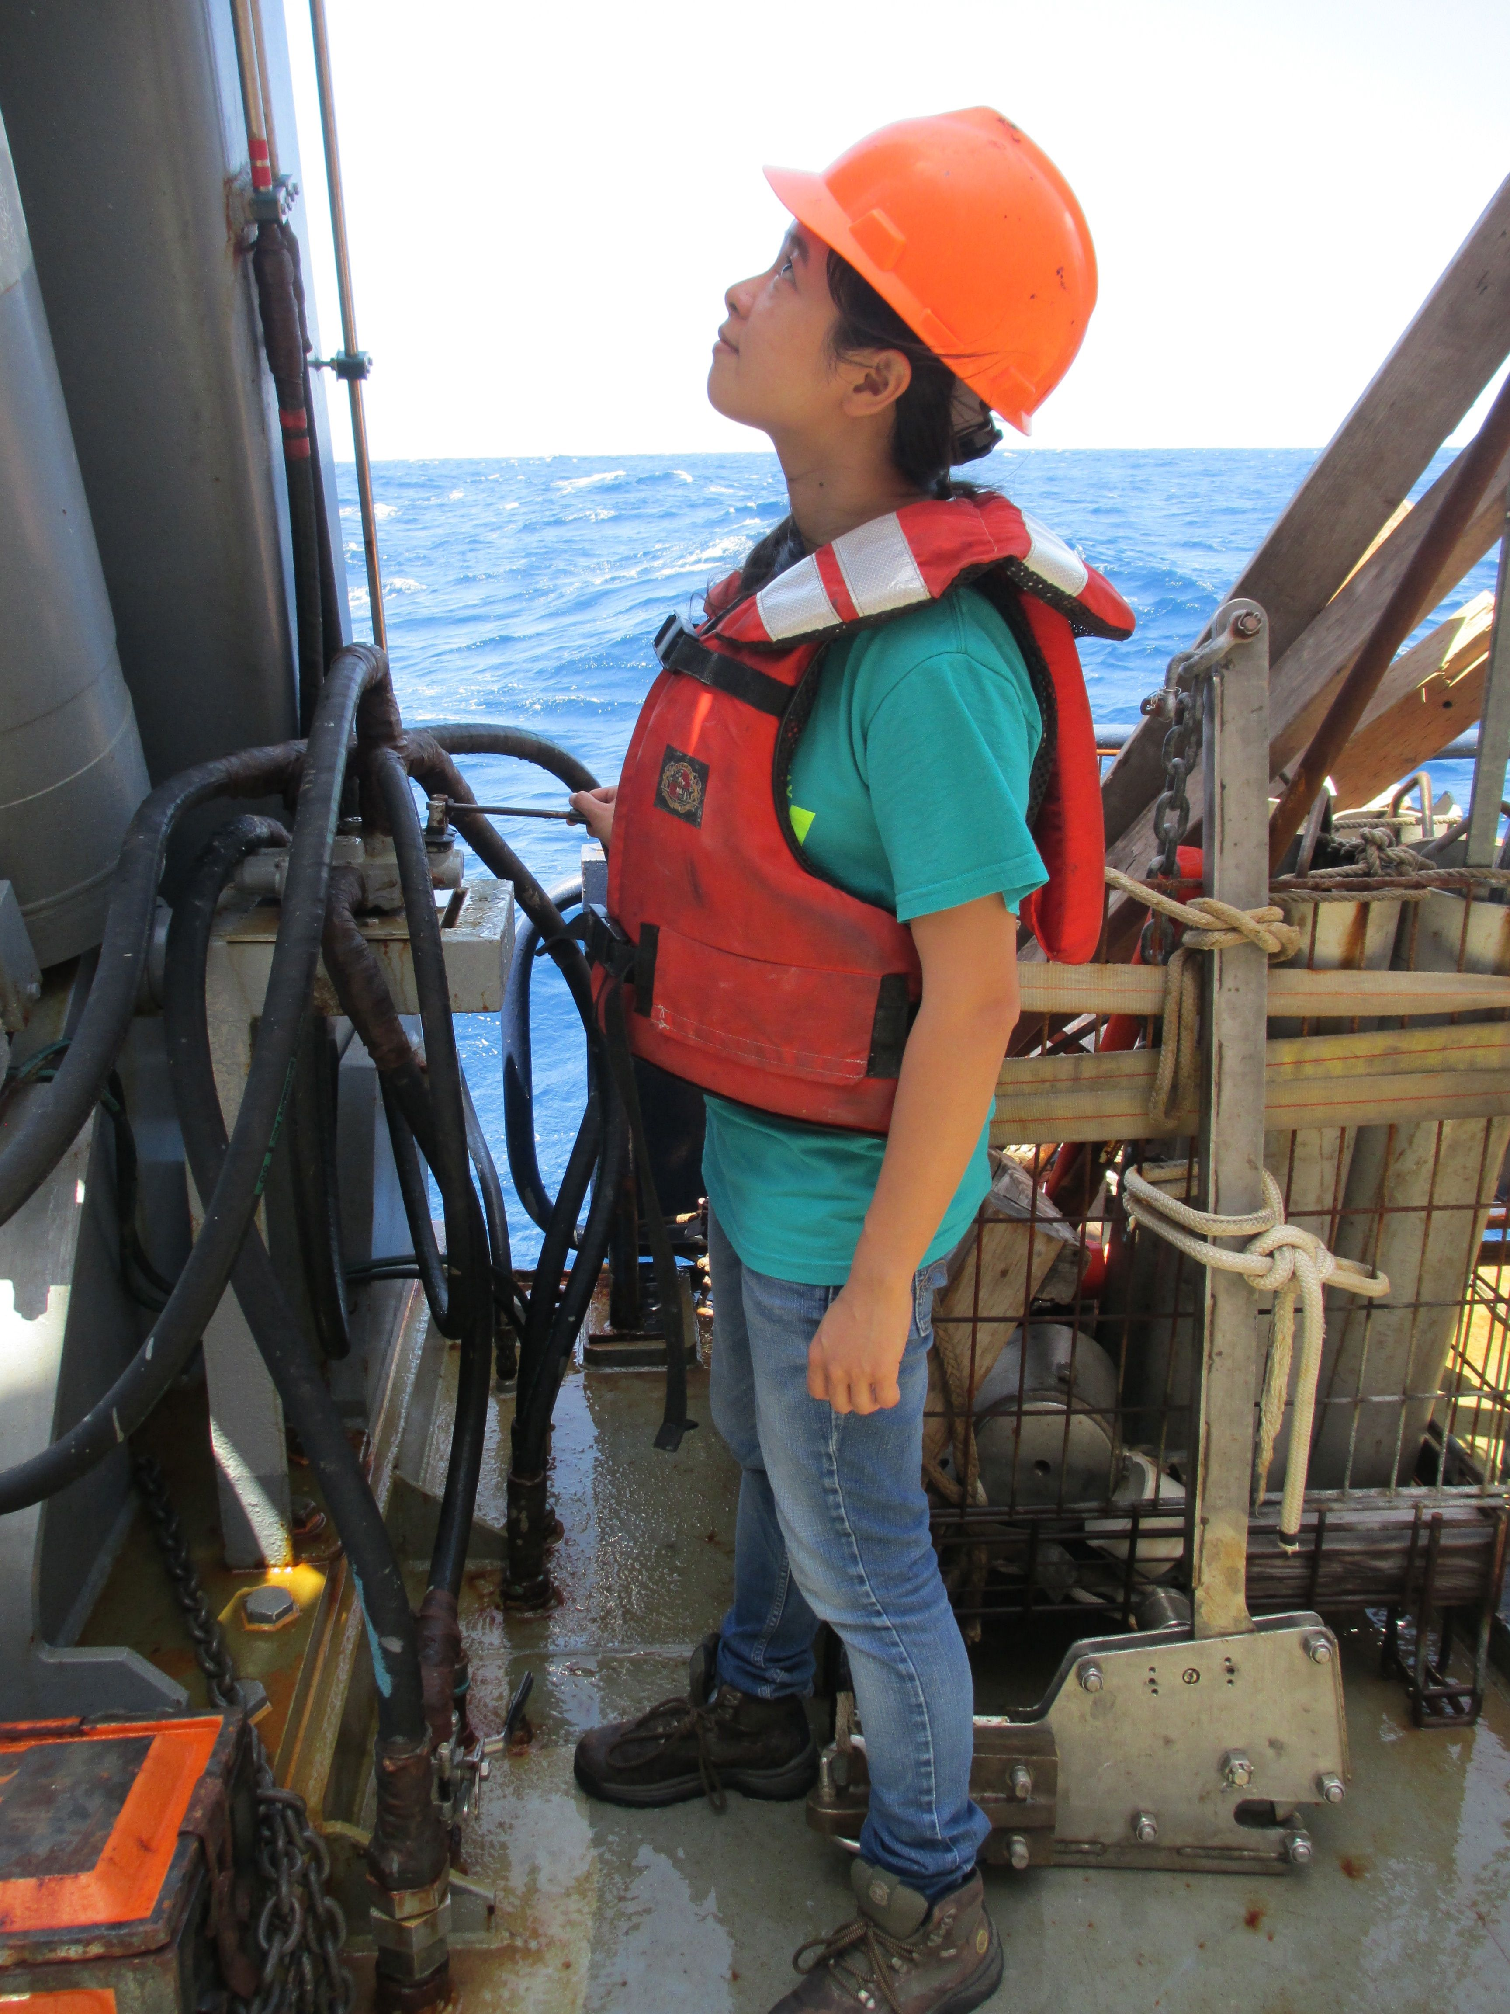
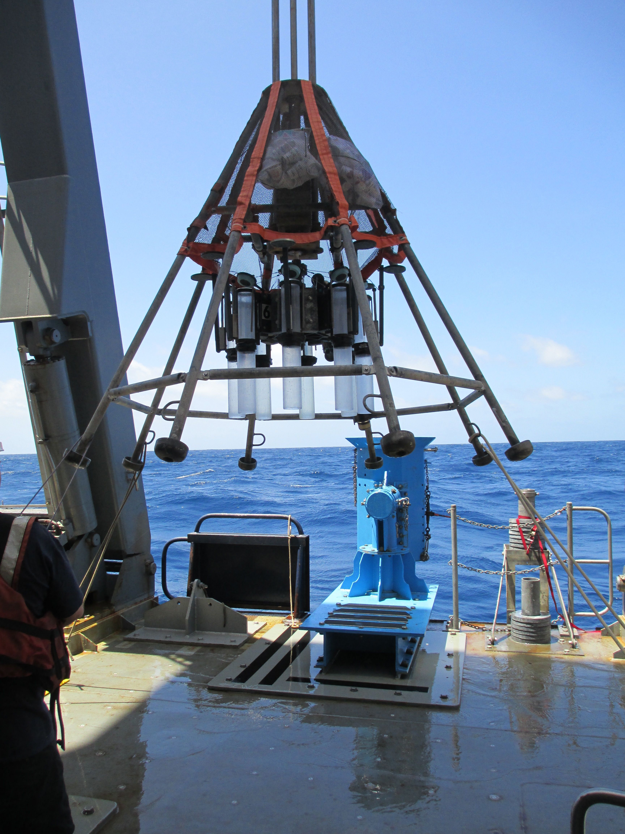

Slide 11
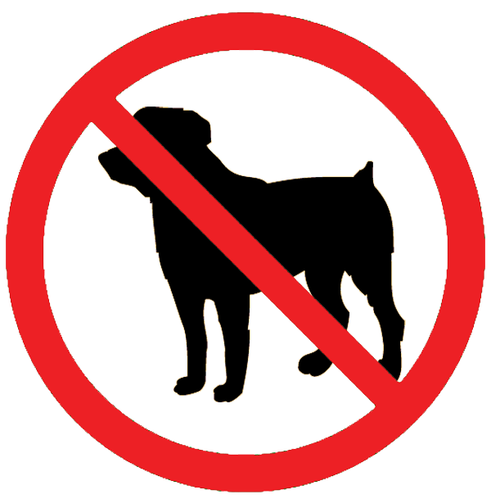

Slide 12
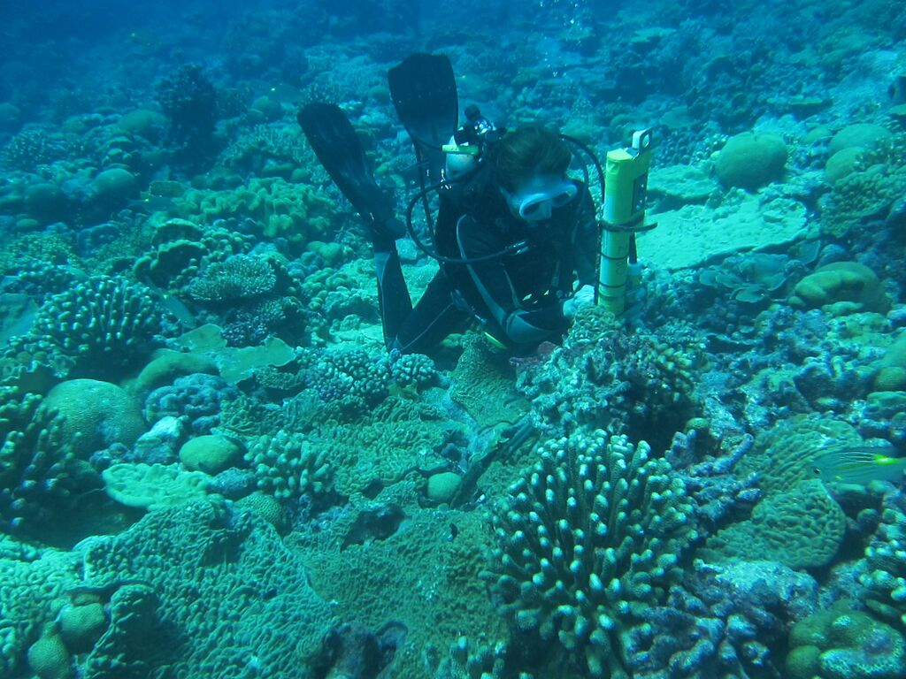

Slide 13
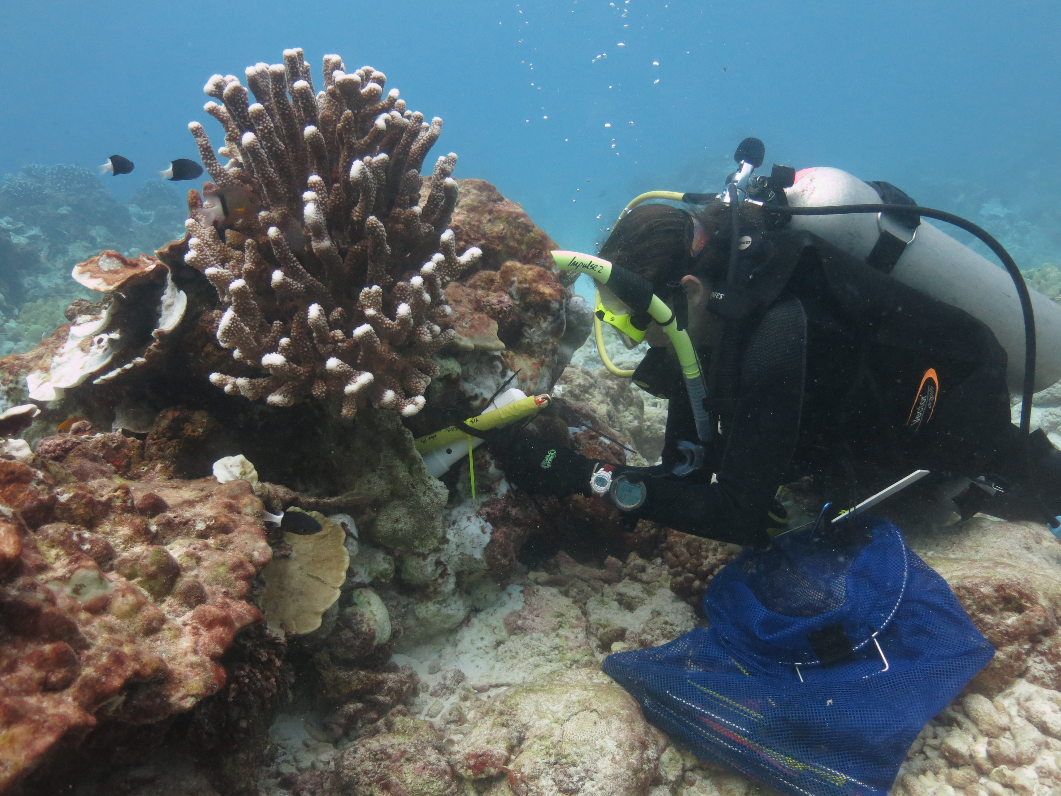

Slide 14
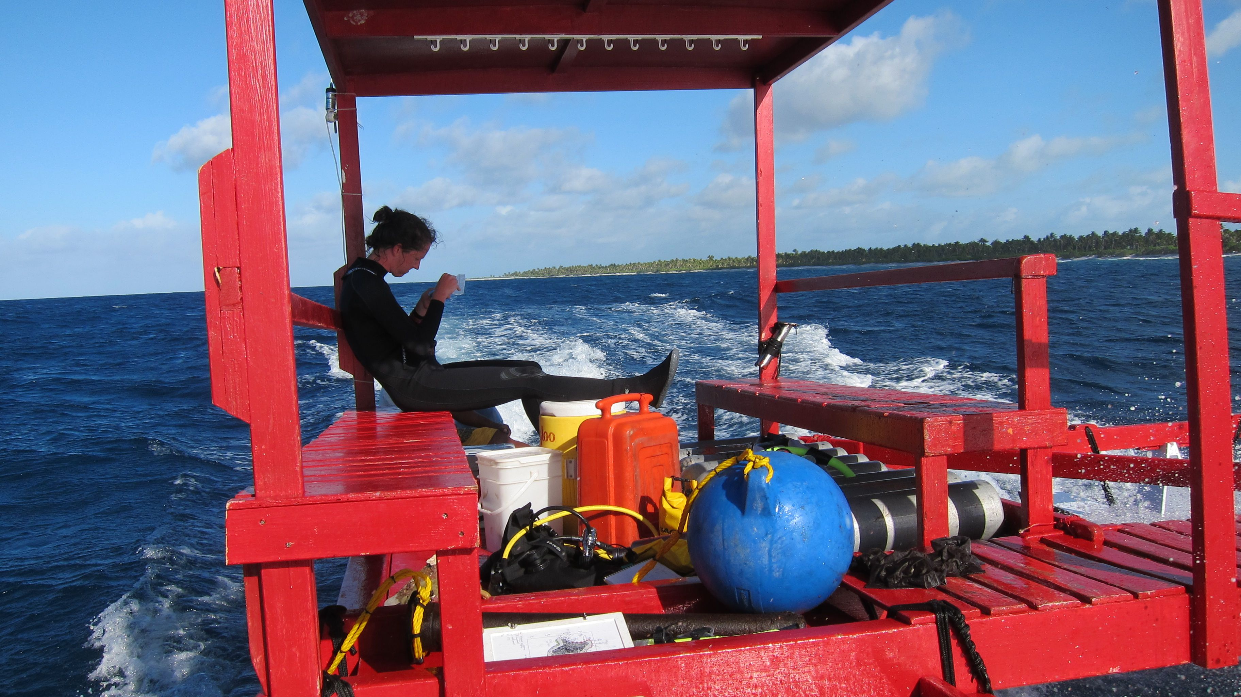

Slide 15
Measurements
ADCP (current logger)
Temperature loggers
Salinity loggers
Water samples
for salinity,
geochemistry
coral drilling for
climate reconstruction

Slide 16
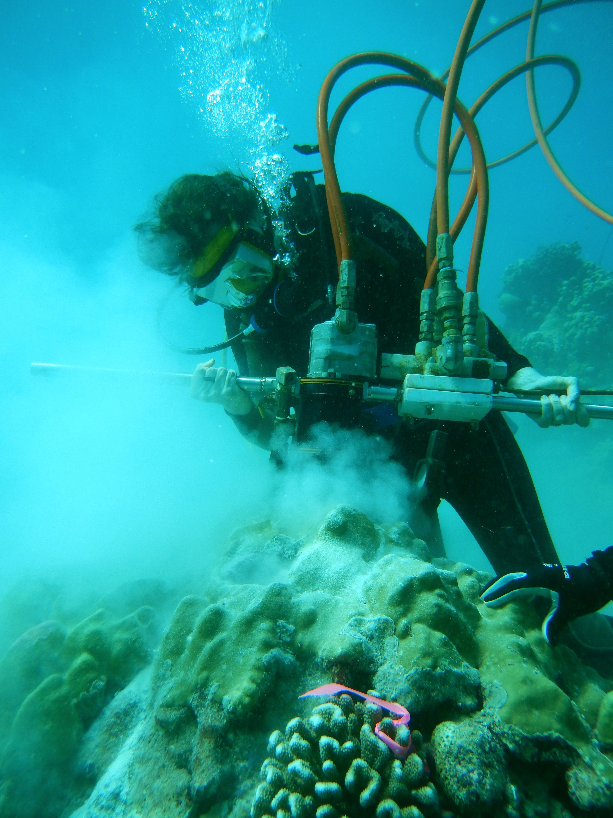

EPISODE 3:
THE SURGE

Slide 17
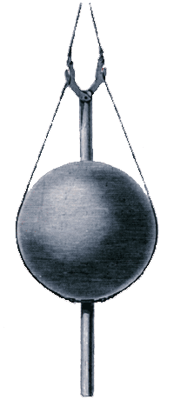
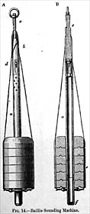
Sounding apparatus
Notes:
Sounding is a method of determining the depth of water by lowering a weighted line from a boat or platform to the bottom, in the case of HMS Challenger, the seafloor. The Challenger stocked 144 miles of rope for sounding and more than twelve miles of piano wire for sampling and dredging.
The Challenger carried a sounding apparatus after the 1853 design of John Mercer Brooke. The twine line had a detachable weight which helped to ensure that the line struck the ocean floor and was not too derailed by the movement of the ship or the currents, increasing the accuracy of the measurements. To use this method of sounding, the crew marked distance along a rope with flags, and then, having attached the weight to the end of the rope, lowered the weight over the side. The crew then noted how fast the flags entered the water. When the weight hit bottom, the entry speed of the flags changed dramatically and the crew knew bottom had been "sounded." A line weighted with 200 kg (450 lbs) would take about 40 minutes to reach a bottom 5 km (approx 3 miles) deep.
At best, Challenger depth measurements could only be expected to be accurate to within 25 fathoms (about 45m or 150 feet) because the sounding line "ruler" was only marked at each 25 fathoms. The fathom equals six feet and was a unit of depth used by the Challenger crew. The name comes from an older word for "reach." A sailor would pull in a rope as far as he could reach, about a six-foot arm-span, and know he'd measured a fathom of depth.

Slide 18
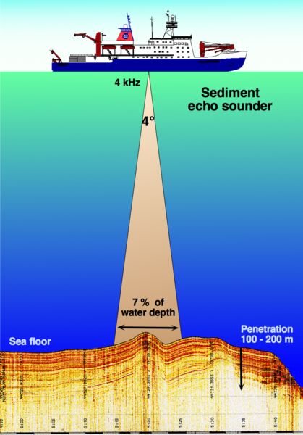
“Sounding” by sound
3.5 khz diagram and picture
Notes:
Why sound? Unlike most EM radiation, sound can penetrate much further (3km with 50% attenuation in seawater)
http://commons.wikimedia.org/wiki/File:Sediment_echo-sounder_hg.png
“Principle of sediment echo sounding. A narrow beam of high energy and low frequency (ab. 3.5 kHz) submitted by the research vessel to the sea floor is reflected by the various layers, providing information about hardness and structure of the sediments. Used by marine geologists as a pre-site survey to find suitable locations for sediment coring.
Date
“
From wikepedia: "Sounding" derives from the Old English sund, meaning swimming, water, sea; it is not related to the word sound in the sense of noise or tones.
Echosounding invented 1904 (Norway), 1920s

Slide 19
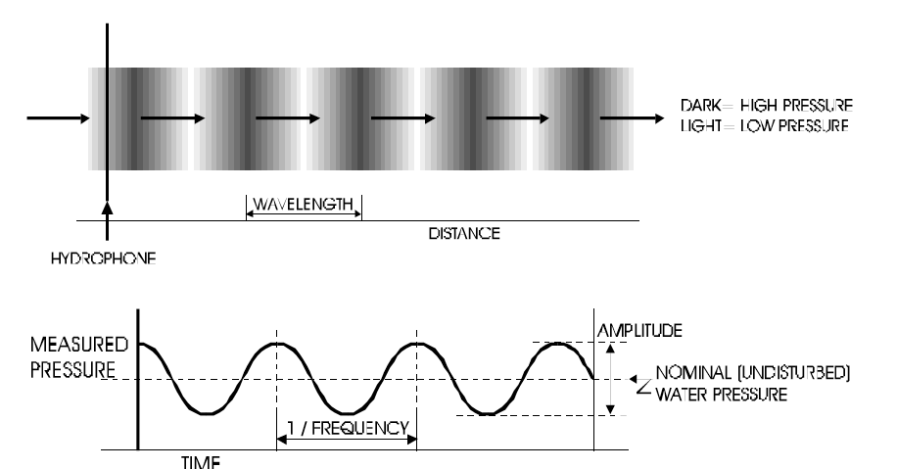
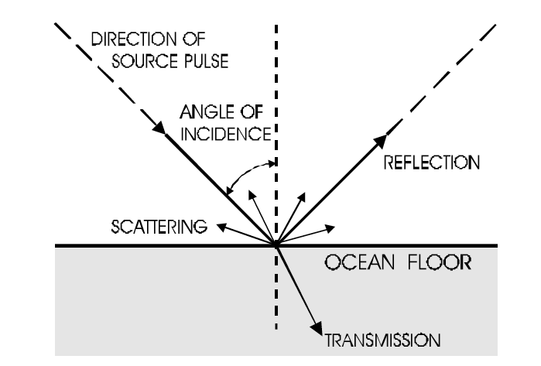
Range = (1/2)*sound speed*echo time
Higher frequencies– more reflection, less penetration
Notes:
When a change in impedence (density*speed of sound) is encountered, some energy transmitted, some reflected. Bigger impedence change, more reflected. How much energy is transmitted vs. reflected (backscattering strength) depends on material– hard bottom reflects, soft sediments transmits. Use analogy of room with hard walls vs. soft absorptive coverings. Also rough surface will scatter more.
Information and figures from seabeam manual
http://www.ldeo.columbia.edu/res/pi/MB-System/sonarfunction/SeaBeamMultibeamTheoryOperation.pdf

Slide 20
Single Beam 3.5 kHz
3.5 khz diagram and picture
Notes:
Sound is directed into a beam to best get depth directly below ship.

Slide 21
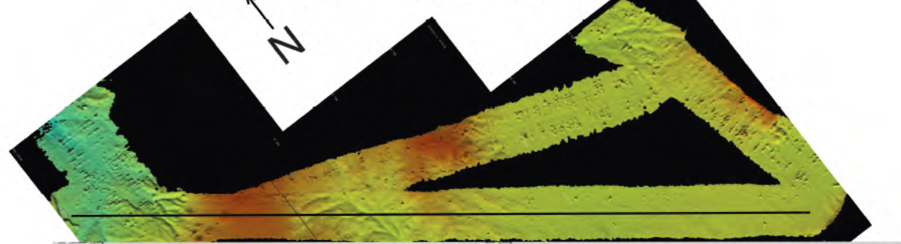
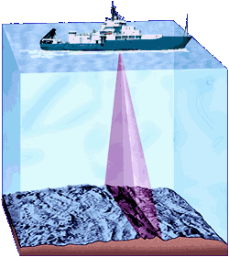
Multi-beam Echo Sounder: measure ocean bathymetry with ship (10-5000m)
like mowing the lawn: be sure
you have overlapping “swathes”

Slide 22
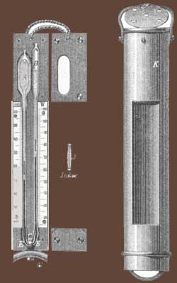
Miller-Casella Deep Sea Thermometer
Notes:
“The Miller-Casella thermometer was used for most of the water temperature readings during the Challenger expedition. Its U-shaped tube held mercury and two floating markers that recorded the highest and lowest water temperature through which the thermometer traveled.
Scientists spaced these thermometers at specific distances along a line and lowered it over the side. Metal cases protected the instruments from bumps and bangs. When the rope was hauled back in, scientists read the thermometers and recorded the temperature for the depth that matched the length of the rope.
Their method assumed that the coldest temperature was measured at the greatest depth and that the warmest water was on the surface. But soon Challenger scientists asked "What if the thermometer had gone through a cold layer of water on its way up?" They needed better thermometers that would reliably record temperature at known depths.
Inventors in England sent improved deep-sea thermometers to the Challenger for testing. They'd developed the new reversing thermometer to solve the problem Challenger scientists faced: how to measure the water temperature at a determined depth, without assuming that the coldest water was necessarily at the ocean bottom.
The Challenger scientists lowered the new reversing thermometer to the chosen depth. Then, by pulling up on the attched rope to release a catch, they flipped the thermometer upside-down and recorded the temperature at that specific depth. “
-------
How a reversing thermometer works
http://www.fao.org/docrep/003/F0752E/F0752E07.htm
“A protected thermometer is so called because it is encased in a sealed glass tube which protects it from being squeezed by the pressure of the water. (Fig. 7.2) The unprotected thermometer has no such protection and the pressure of the water squeezes the glass and makes the temperature of the unprotected thermometer read higher than that of the protected. Because the pressure of the water is proportional to depth the true depth at which the sample was taken can be calculated.
The main thermometer has a special construction. It consists of a main expansion bulb (Fig. 7.2) and a smaller one at the other end of the tube. The capillary of the tube has two constrictions (Fig. 7.2). The thermometer is lowered with the main bulb lowermost and the mercury in the main bulb expands to fill the capillary and part of the smaller expansion bulb. When the messenger hits the bottle and reverses the frame the mercury column breaks at the lower constriction leaving a column of mercury which is now isolated from the main expansion bulb and whose volume was dependent upon the temperature at the sampling point. The volume of this mercury and therefore the temperature which is recorded will still depend upon the temperature at which the main thermometer is read so each main thermometer has an associated auxiliary thermometer to record this (Fig. 7.2). The main thermometers are read to an accuracy of 0.01°C and the auxillary thermometer to 0.1°C, usually with a special reader incorporating a light and a magnifying glass.”

Slide 23
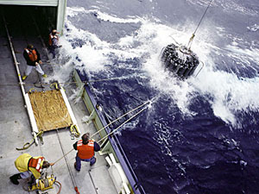
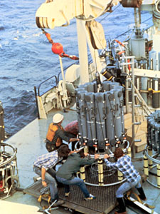
Conductivity-Temperature-Depth (CTD): measures T and S (density )in ocean
deployed off ship usually;
data fed back to ship in realtime
Niskin bottles sample ocean water at predetermined depths
“casts” can take many hours

Slide 24
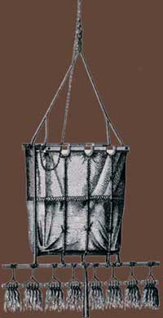
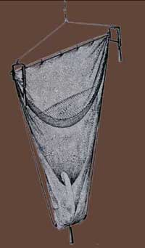
Dredge and Trawls
sieves
dredge
Notes:
A dredge took samples along the surface of the seafloor while being dragged across the bottom. The Challenger dredges were between 3 and 5 feet in width and were just metal nets shaped into bags. A piece of tightly woven cloth in the bottom of the bag trapped small animals and samples of mud. The swabs, or "tangles," attached to the bottom of the dredge were standard Navy-issue mops that were very good at sweeping up smaller organisms.
Trawls were rugged metal nets used at a variety of depths to collect larger animals. The Challenger crew found it easier to use trawls, rather than the heavier and more awkward dredges, when collecting life from the bottom.
Nets of different size and mesh were the primary tool aboard Challenger for collecting living samples from all depths of the ocean. A tow net was attached at various depths on the sounding line, and collected both floating and slow-swimming life forms.

Slide 25
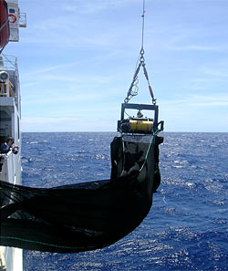
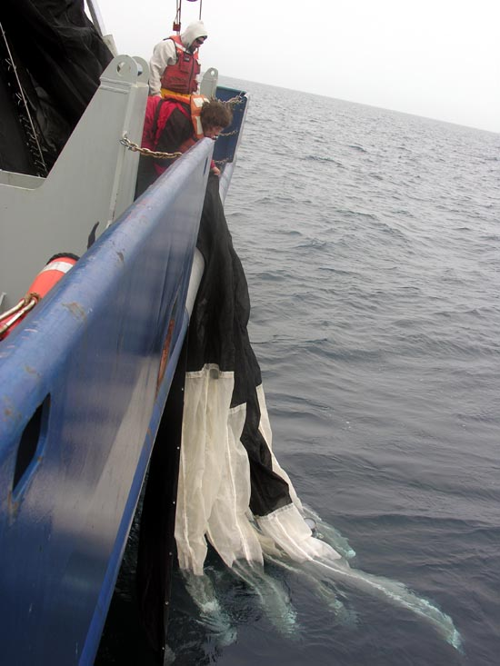
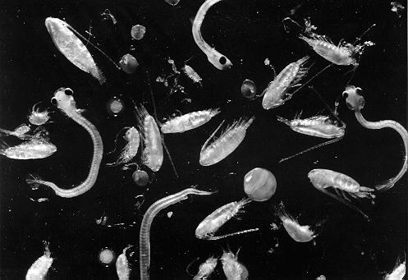
MOCNESS: multiple open and closing net with an environmental sampling
system; used to collect plankton

Slide 26
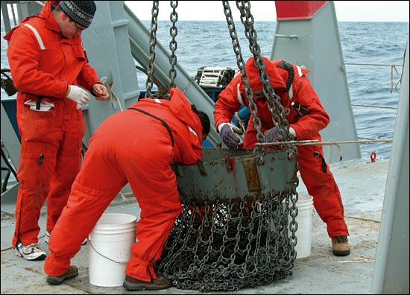
Dredging for volcanic rocks on R/V Knorr
Notes:
https://www.whoi.edu/cms/images/currents10n03_dredge_en_47980.jpg

Slide 27
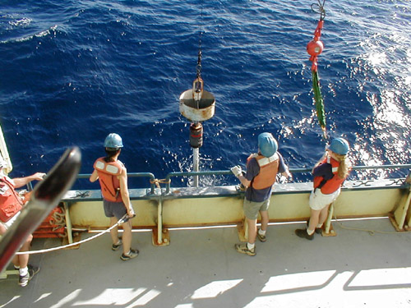

Slide 28
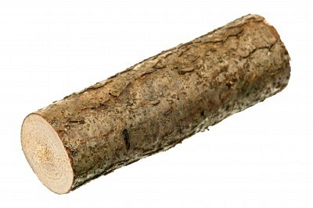
Notes:
The log was a simple float the Challenger scientists used to measure surface current. From an anchored boat, sailors threw the log attached to a rope into the water. Scientists noted the direction the log was moved by the current. After a period of time passed, they measured the length of rope pulled overboard by the float and divided this distance by the time, to get the speed of the surface current.
The current drag measured currents below the surface. The weighted drag hung below a surface float so it could drift along in deeper currents. Scientists calculated the velocity of the drag's surface float, and taking into account the surface current measured with a log, they calculated the velocity of the deeper current.
Modern current meters have various designs. Basically they either move with the current as drifters, or are stationary and hold one position as the water moves past.

Slide 29
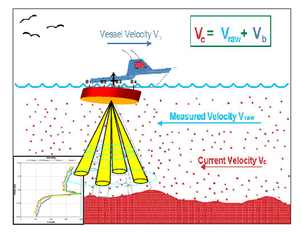
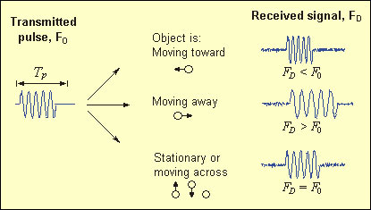
Acoustic Doppler Current Profiler (ADCP): measure velocity in ocean by
pinging sound waves and analyzing the return wave
http://chair.pa.msu.edu/applets/doppler/a.htm
Notes:
http://www.whoi.edu/science/instruments/
http://www.rdinstruments.com/pdfs/VesselMountedADCPIntro.pdf

Slide 30
Modern oceanography rarely conducted by ship
Moored and ocean bottom instrumentation
https://climatedataguide.ucar.edu/climate-data/tropical-moored-
buoy-system-tao-triton-pirata-rama-toga

Slide 31
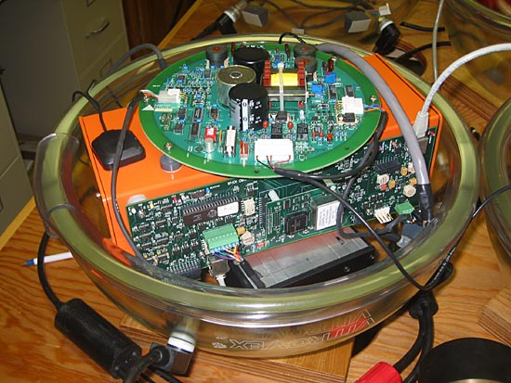
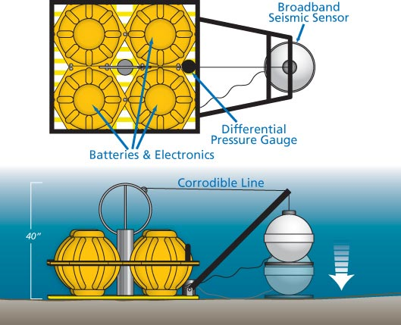
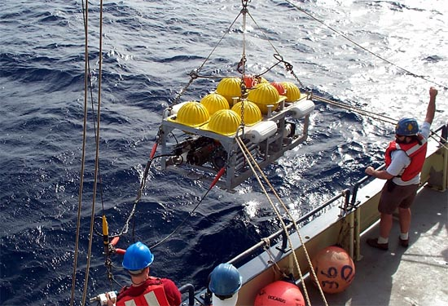
Ocean Bottom Seismometer: measure underwater earthquakes

Slide 32
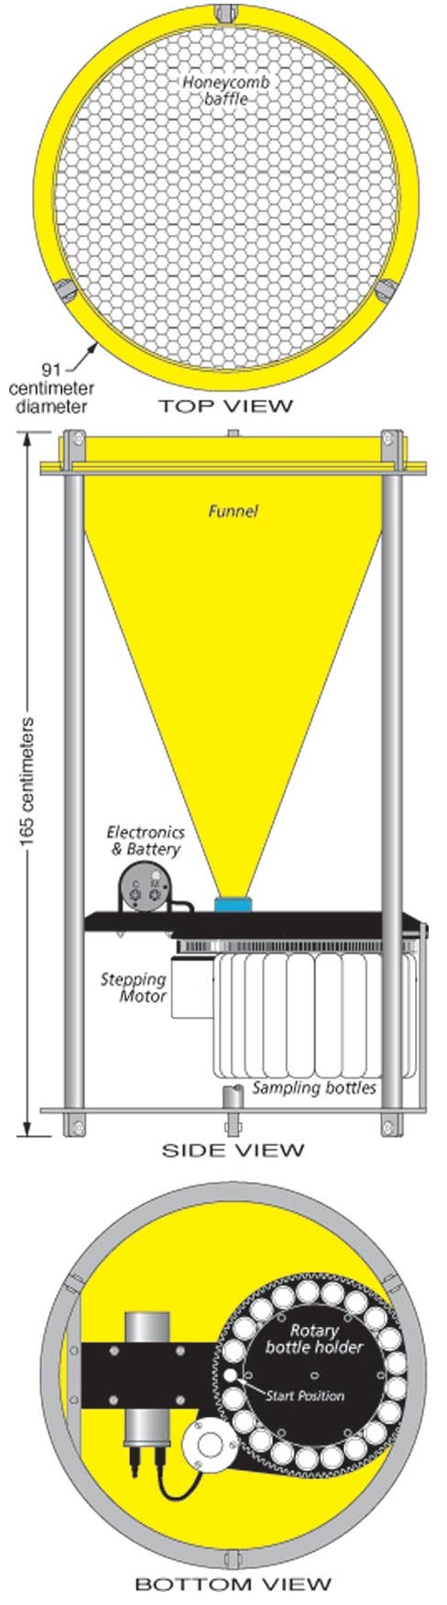
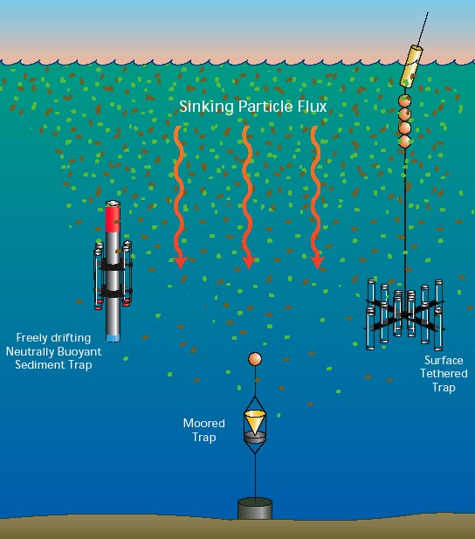
Sediment trap: collect falling sediments in ocean

Slide 33
Much oceanography no longer from ships
Moored and ocean bottom instrumentation
Free drifting instrumentation

Slide 34
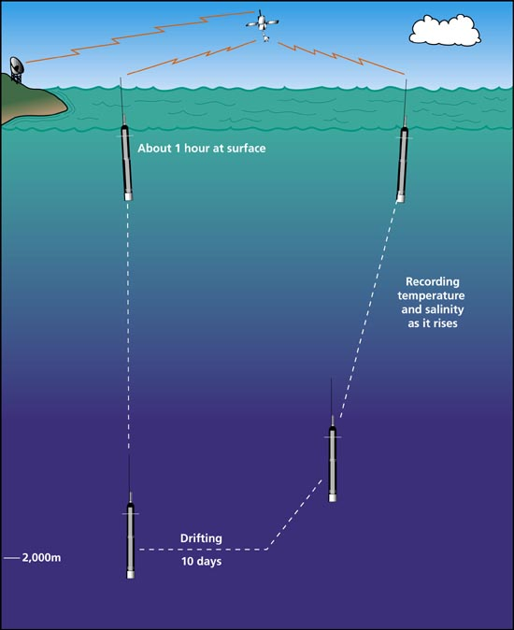
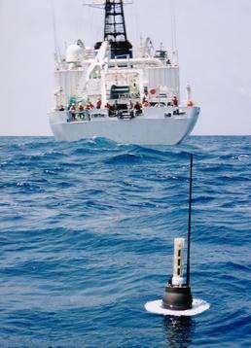
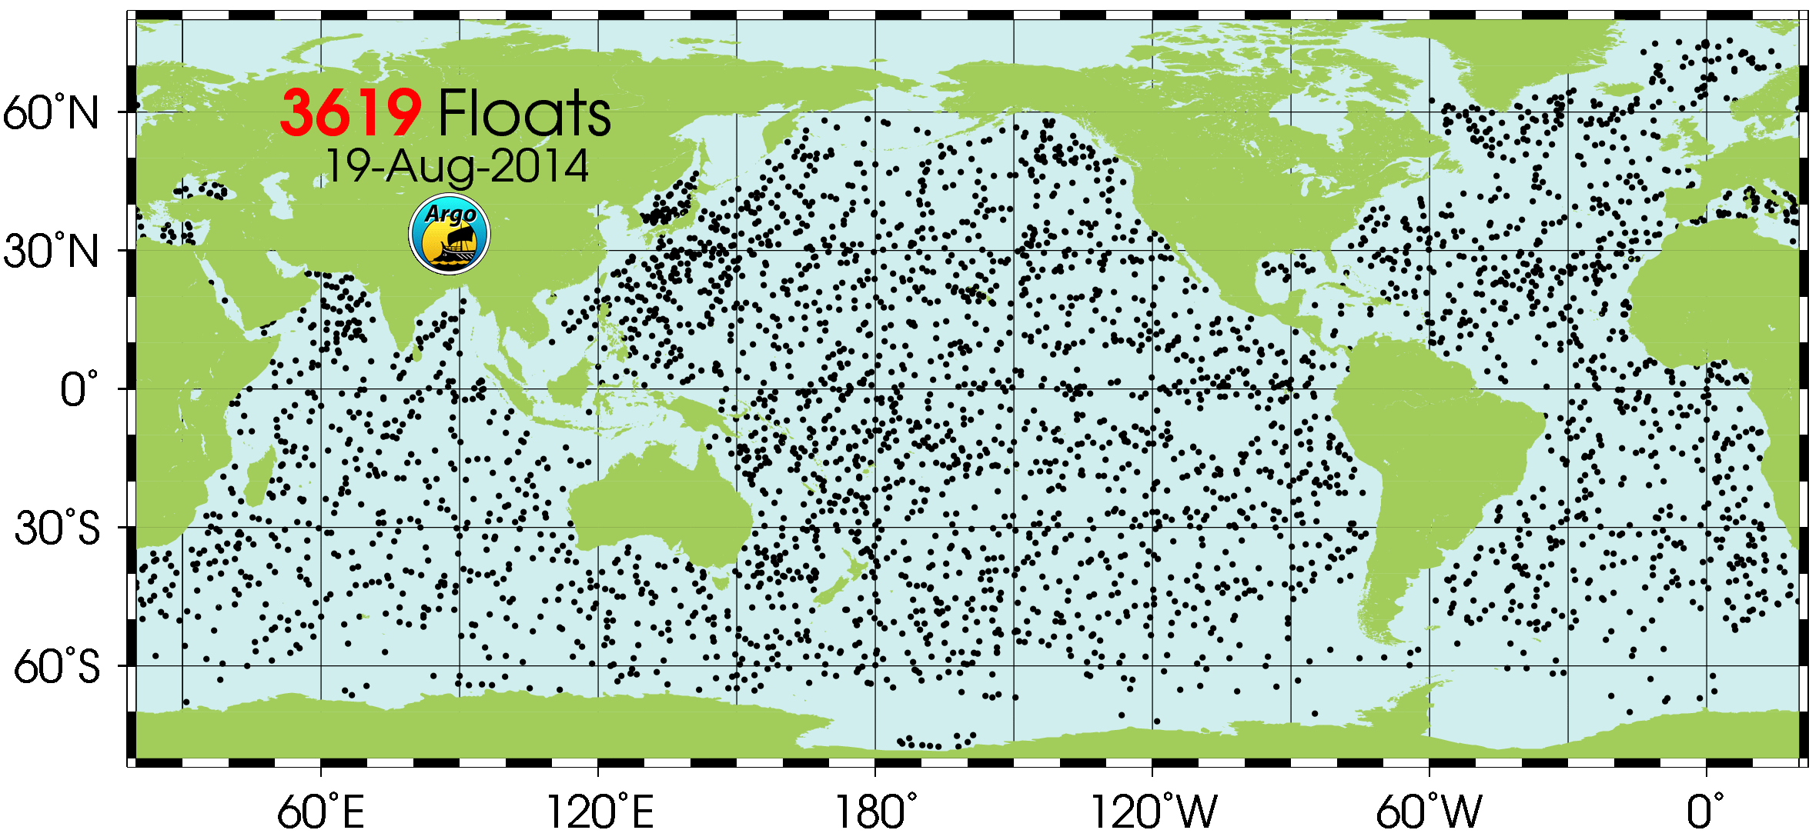
ARGO floats: measure ocean T and S while drifting with ocean currents,
surface regularly to communicate with satellites to transmit data
Notes:
Continuous T and S profiles to 2km. New ones will go to 3km
http://www.argo.ucsd.edu/About_Argo.html
“The array of ~3200 floats provides 100,000 temperature/salinity (T/S) profiles and velocity measurements per year distributed over the global oceans at an average 3-degree spacing. Floats will cycle to 2000m depth devery 10 days, with 4-5 year lifetimes for individual instruments. All data collected by Argo floats are publically available in near real-time via the Global Data Assembly Centers (GDACs) in Brest, France and Monterey, California after an automated quality control (QC), and in scientifically quality controlled form, delayed mode data, via the GDACs within one year of collection. “
Funded internationally

Slide 35
Much oceanography no longer from ships
Moored and ocean bottom instrumentation
Free drifting instrumentation
Remotely operated vehicles

Slide 36
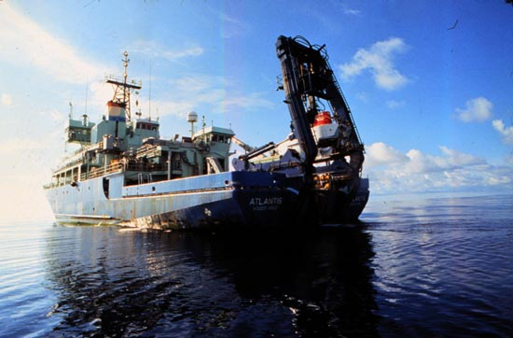
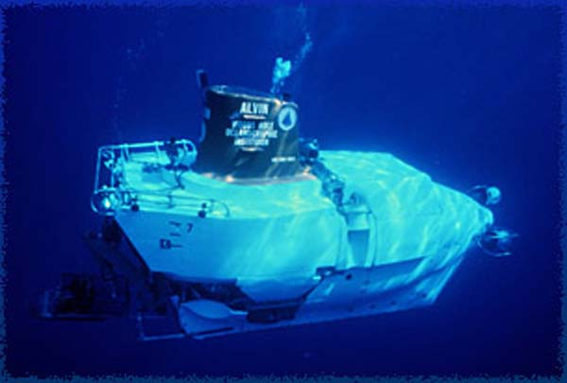
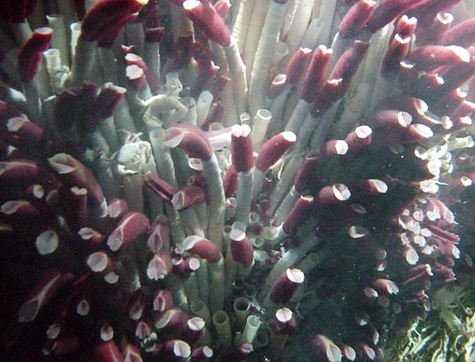
Alvin: a 3-person submersible that can dive to 4.5km
1977: discovered hydrothermal vents

Slide 37


Notes:
Widely in use in oil and gas industry. Much more efficient for most things than sending people down.

Slide 38
Much oceanography no longer from ships
Moored and ocean bottom instrumentation
Free drifting instrumentation
Remotely operated vehicles
Satellites

Slide 39


Temperature, Salinity, Wind speed. Sea ice, surface topography, bottom topography, ocean color
altimetry
Notes:
http://www.ospo.noaa.gov/data/sst/anomaly/2014/anomnight.1.2.2014.gif

Slide 40
Satellite Altimetry record
http://sealevel.colorado.edu

